Slide 1
Natural Resources Law
Lecture #1
February 6, 2018

Slide 2
My Contact Info
Office: 722
Office Hours: Tuesdays/Thursdays 12:15 to 2pm and by appointment
E-mail: jol@buffalo.edu
Telephone: 645-8182 (but e-mail preferred)

Slide 3
Introductions
Tent Cards
  Write (on both sides) what you would like to be called
Index Cards
  Name
  E-mail Address
  Hometown (you decide how to define that)
  Undergraduate Institution & Major (any grad degree?)
  Interesting Job
  One of your hobbies

Slide 4
Syllabus
8 “Written” Assignments
  Some of in-class.
  Some at home
  Some with partners
  Some alone
No exam
Class Participation
Computer Policy and Recordings

Slide 5
ROOM CHANGE
Beginning next week, we will be in Room 406.

Slide 6
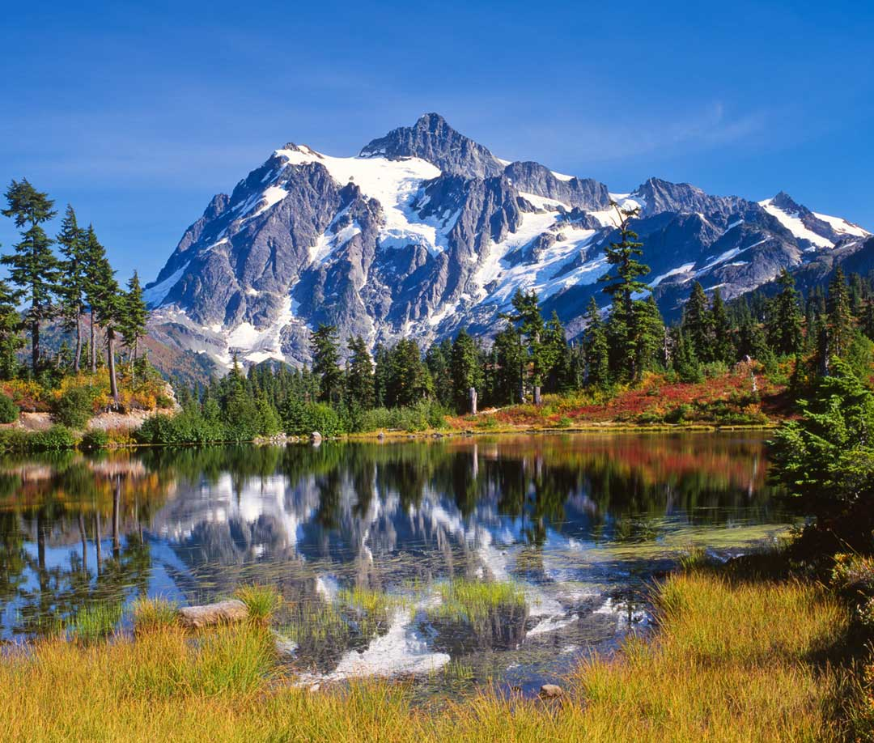
What Are Natural Resources?

Slide 7
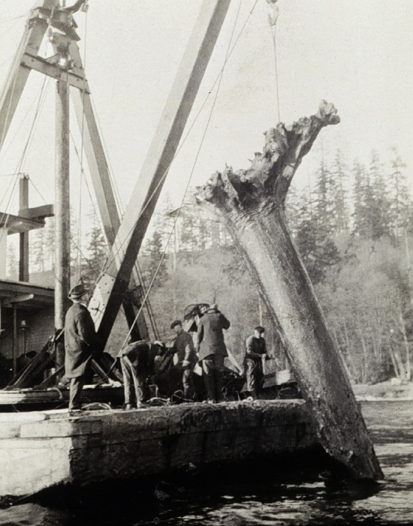
In Re Tortorelli
66 P.3d 606 (Wash. 2003)
p. 10

Slide 8
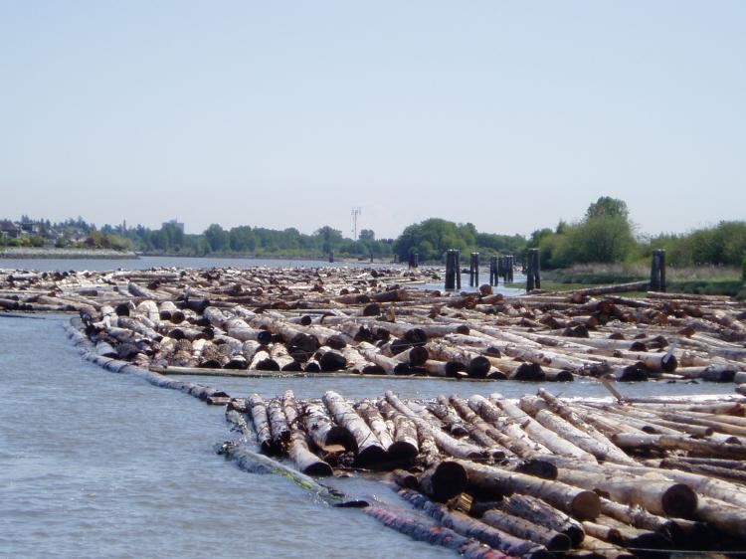
Stray Logs

Slide 9
Who owns the logs?
  The State?
    State Constitution
    Equal Footing Doctrine
    Submerged Lands Act

Slide 10
Submerged Lands Act
… without limiting the generality thereof, oil, gas, and all other minerals, and fish, shrimp, oysters, clams, crabs, lobsters, sponges, kelp, and other marine animal and plant life.”

Slide 11
Definition of Natural Resources
Webster’s Third New International Dictionary:
Natural resources are “materials . . . supplied by nature.”

Slide 12
Dissent
    “… oil, gas, and all other minerals, and fish, shrimp, oysters, clams, crabs, lobsters, sponges. Kelp, and other marine animal and plant life.”

Slide 13
Conservation v. Preservation

Slide 14
Conservation
Utilitarianism
Progressive Era
  Scientific Management
  Faith in Government
Public Land Ownership
  Government as the guardian of public welfare
Intergenerational Equity
Players
  Roosevelt
  Pinchot

Slide 15
“The nation behaves well if it treats the natural resources as assets which it must turn over to the next generation increased and not impaired in value. That is what I mean by the phrase, conservation of natural resources. Use them; but use them so that as far as possible our children will be richer, and not poorer because we have lived.”
Theodore Roosevelt, The New Nationalism (1910)

Slide 16
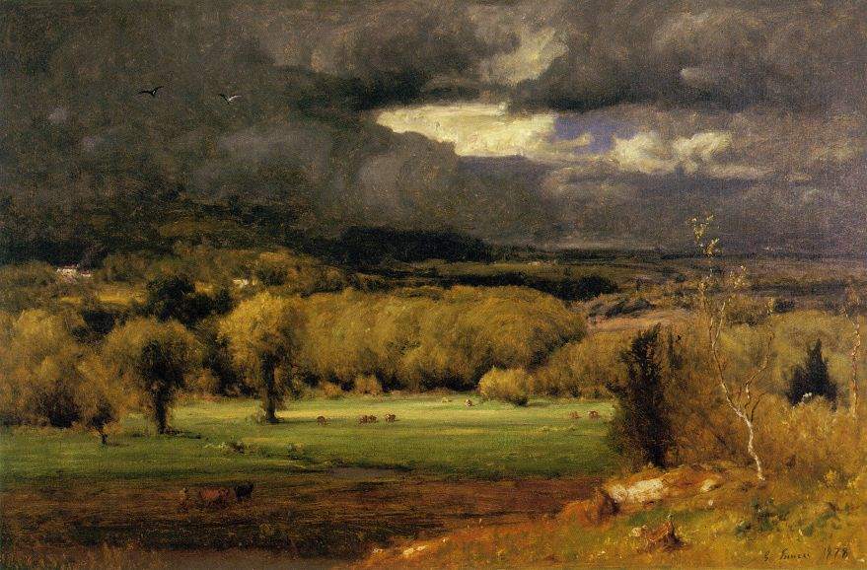

Slide 17
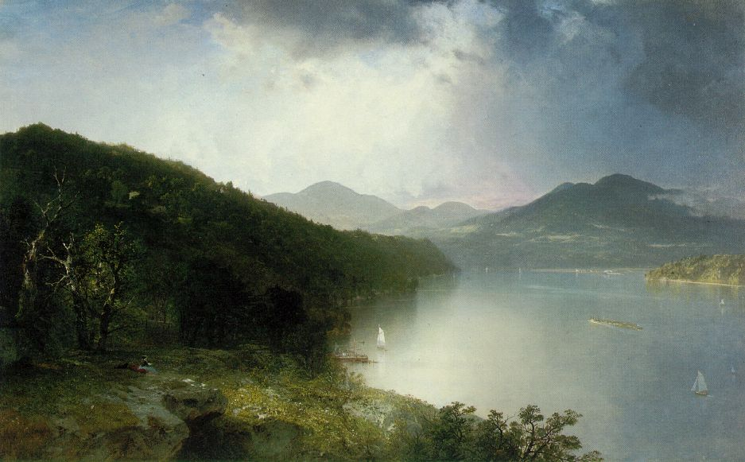

Slide 18
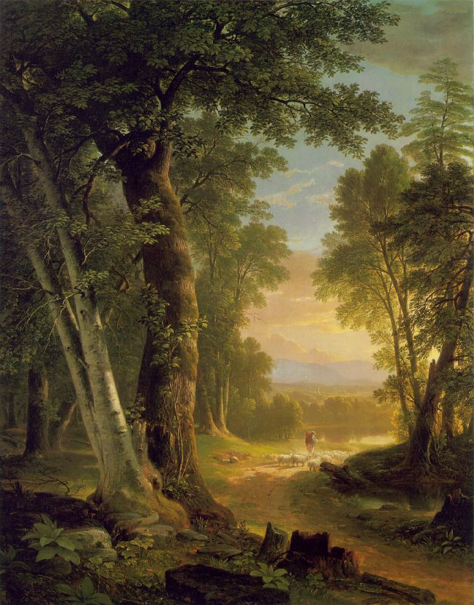
Asher Durand The Beeches (1845)
Notes:
Source: The Metropolitan Museum of Art, New York
http://www.artchive.com/artchive/D/durand/durand_beeches.jpg.html

Slide 19
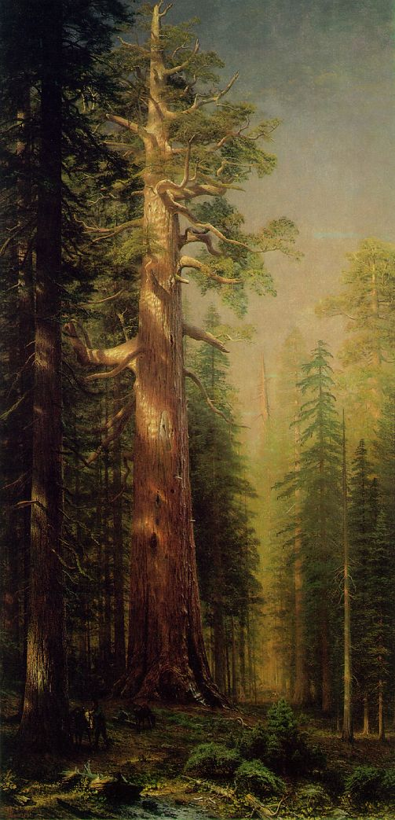
Preservation
Preservation
Saving Wild Places
  Minimal human intervention or use
  Public ownership of land
  Yellowstone
Players
  Muir
  Thoreau
Albert Bierstadt
The Great Trees, Mariposa Grove, California (1876)

Slide 20
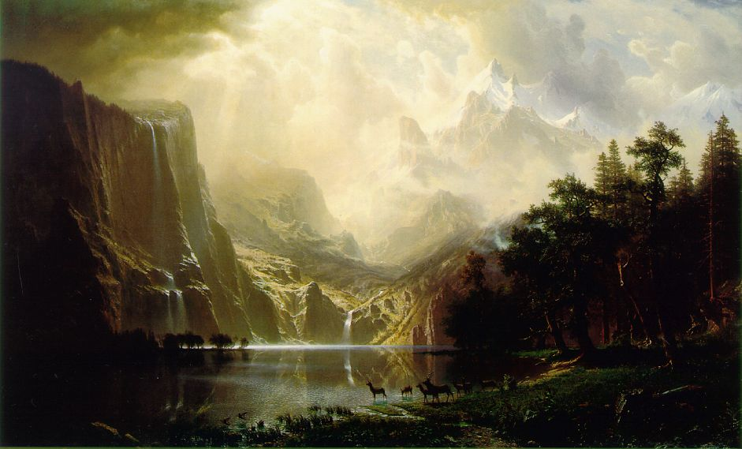

Slide 21
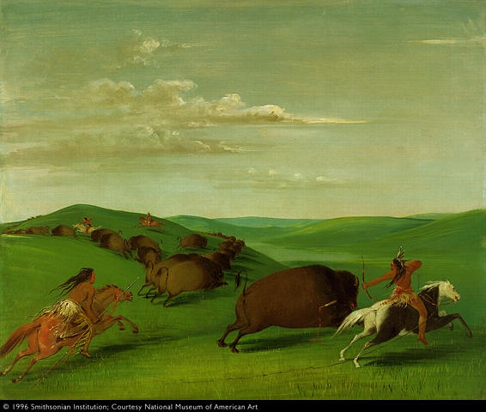
Notes:
Source: National Museum of American Art, Smithsonian Institution\
George Catlin, Buffalo Chase With Bows and Lances (1832-1833)

Slide 22
George Catlin (1832)
“[Indian civilization, wildlife, and wilderness might be preserved] “by some great protecting policy of government . . . in a magnificent park. . . . A nation’s park, containing man and beast; in all the wild and freshness of their nature’s beauty!”
Notes:
Source: Dwight T. Pitcaithley (Chief Historian, National Park Service), Philosophical Underpinnings of the National Park Idea, http://www.cr.nps.gov/history/hisnps/NPSThinking/underpinnings.htm

Slide 23
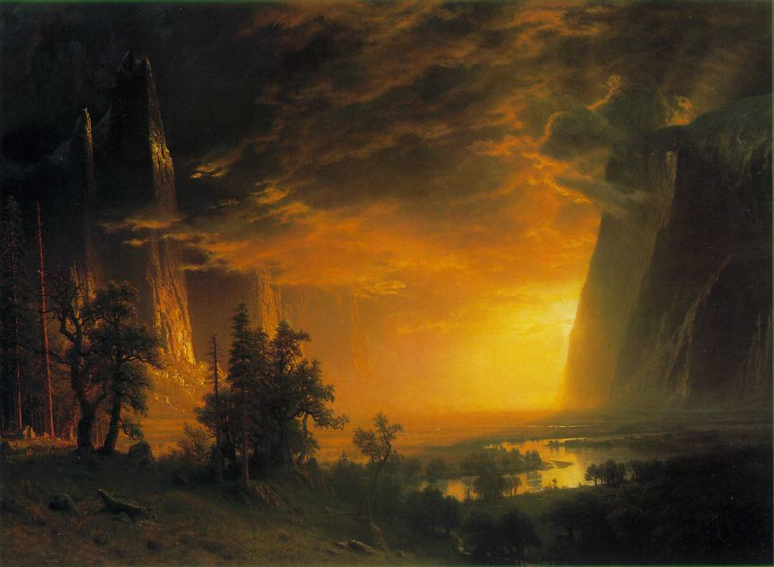
Notes:
Albert Bierstadt, Sunset in the Yosemite Valley (1868)

Slide 24
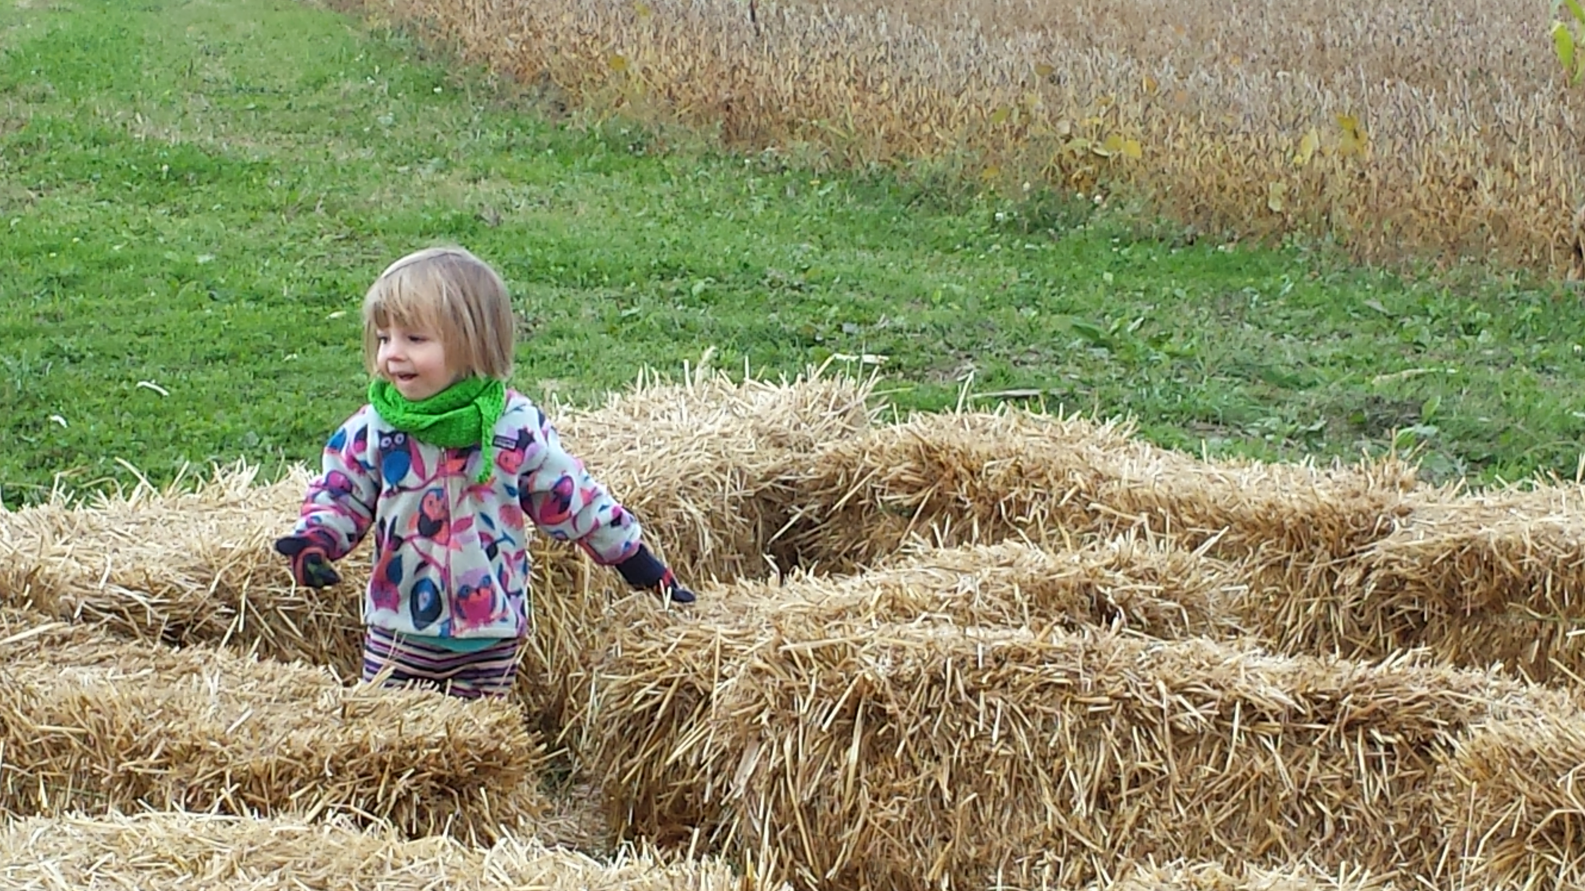
Importance of Place

Slide 25
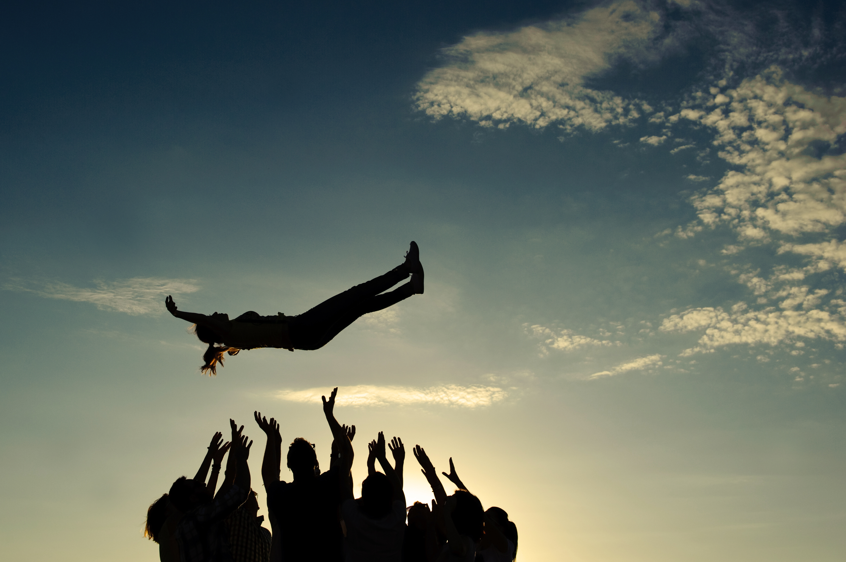
The Trust Notion

Slide 26
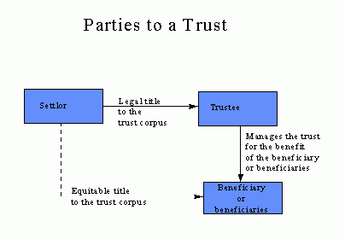
The Trust Notion
Fiduciary Relationship
  Duty
Actors
  Settlor
  Res / Corpus
  Trustees
  Beneficiaries
Charitable Trust

Slide 27
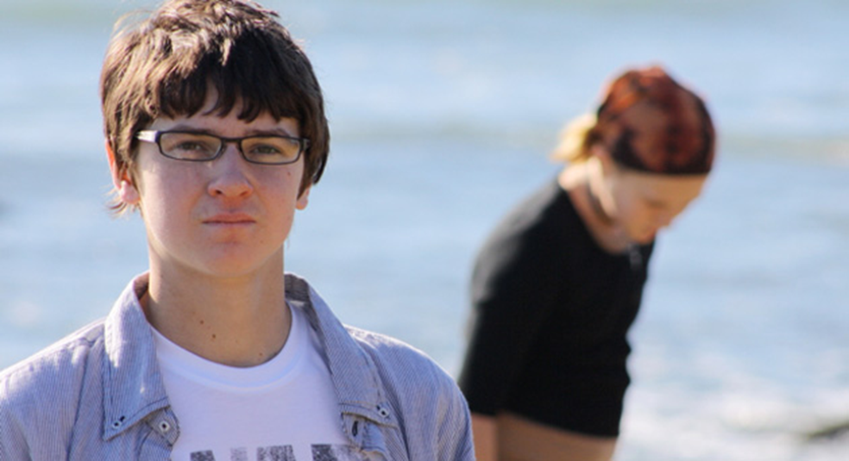
Alec L. v. Jackson
863 F.Supp2d 11 (D.D.C. 2012)
p. 23

Slide 29
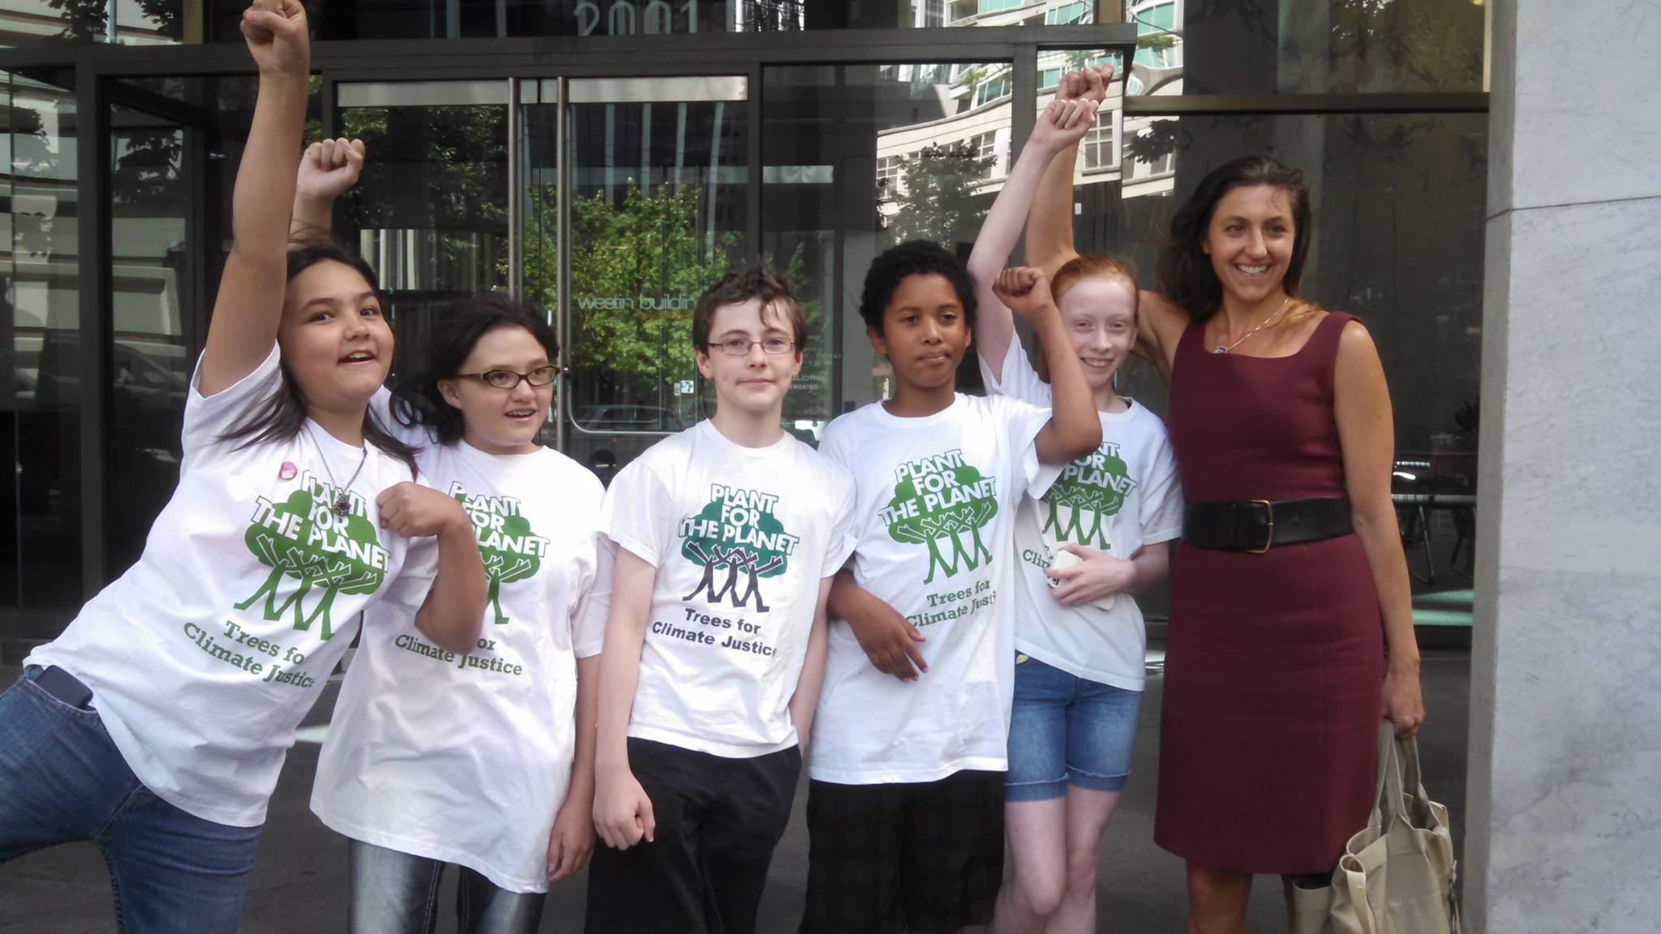
Foster v. Washington Dep’t of Ecology
State Superior Court (11/19/15)Judge Hollis Hill

Slide 30
