Slide 1
Natural Resources Law
February 8, 2018
Class #2

Slide 2
FEDERAL LANDS
Historical Background

Slide 3
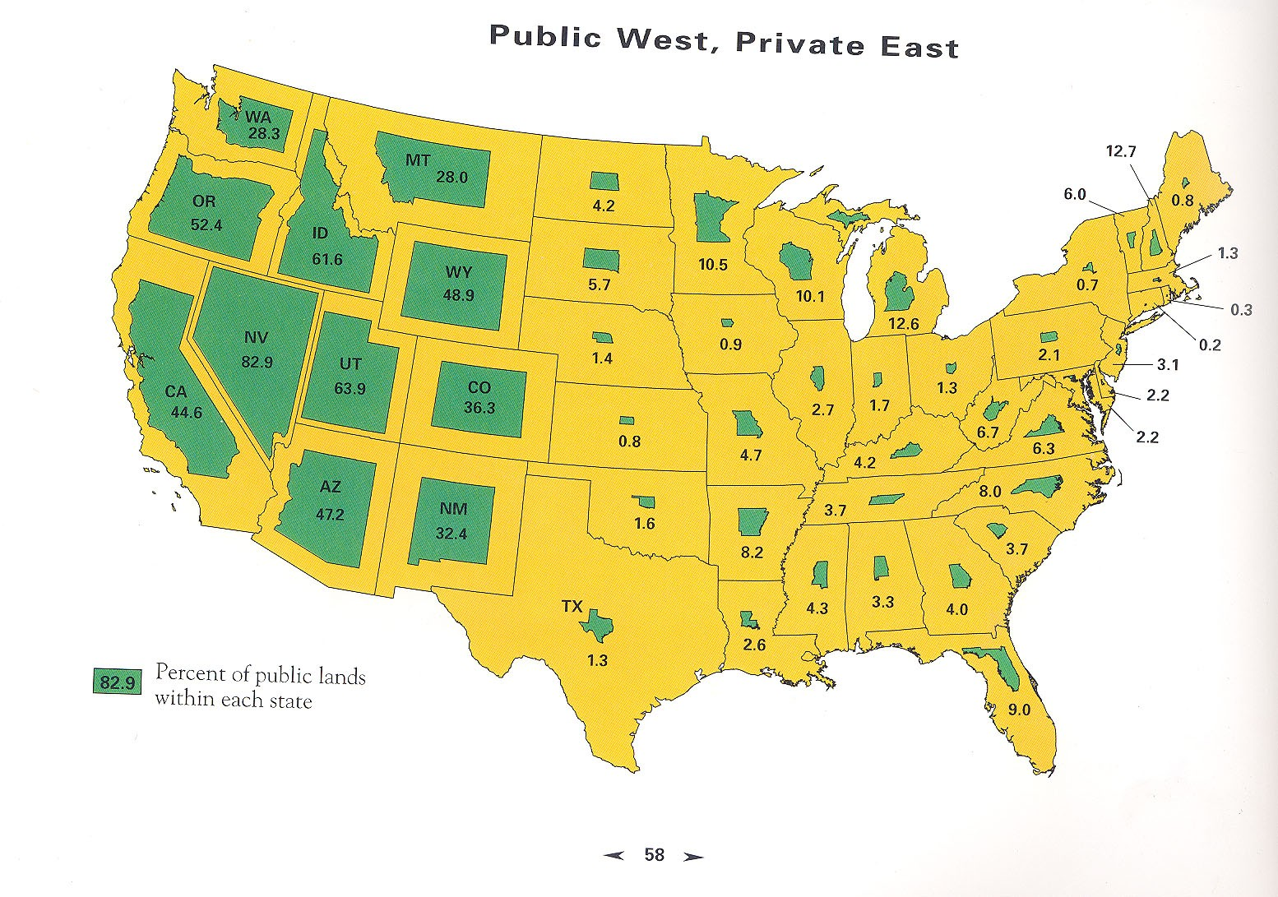
University of Colorado Center of American West,
Atlas of the New West (William E. Riebsame, General Editor)

Slide 4
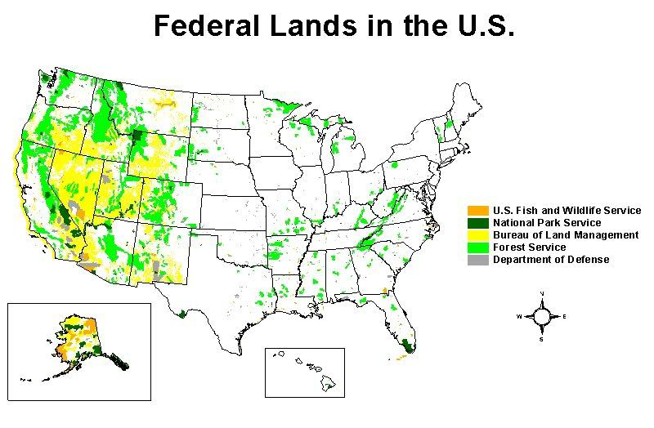
www.defenders.org/publiclands/images/landsmap.jpg

Slide 5
Historical Background
The Birth of the Public Domain

Slide 6
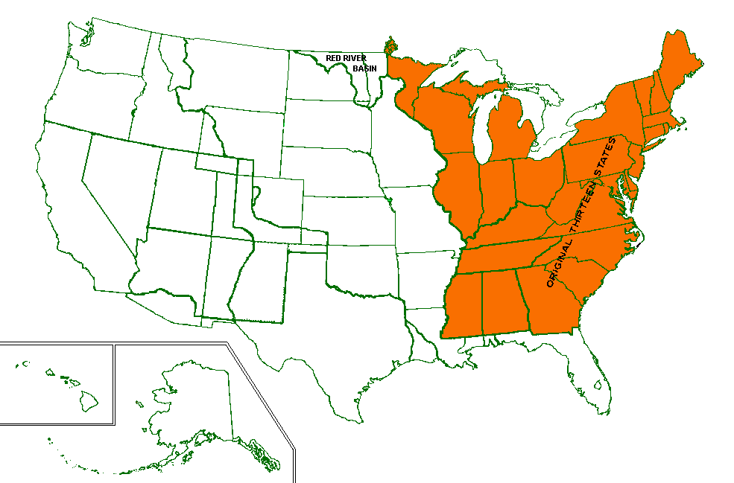
Acquisition of the Territory of the United States

Slide 7
Articles of Confederation
Adopted by the Continental Congress in 1777
Then ratified by the states.
“Those states which can remove the embarrassment respecting the western country, [to make] a liberal surrender of a portion of their territorial claims, since they cannot be preserved entire without endangering the stability of the general confederacy; to remind them how indispensably necessary it is to establish the federal union on a fixed and permanent basis, and on principles acceptable to all its respective members”

Slide 8
Continental Congress 1780 Statement
Such lands if surrendered, would be disposed of for the common benefit of the United States and settled and forming into distinct republican states.

Slide 9
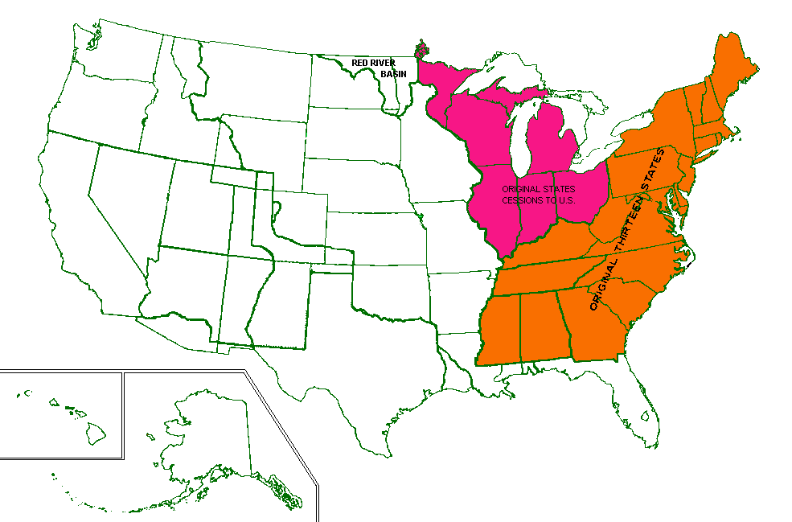

Slide 10
1783 Cession of the Virginia Legislature
Upon condition that the territory so ceded, shall be laid out and formed into states, containing a suitable extent of territory, not less than one hundred, nor more than one hundred and fifty miles square, or as near thereto as circumstances will admit; and that the states so formed, shall be distinct republican states, and admitted members of the federal union; having the same rights of sovereignty, freedom and independence, as other states.

Slide 11
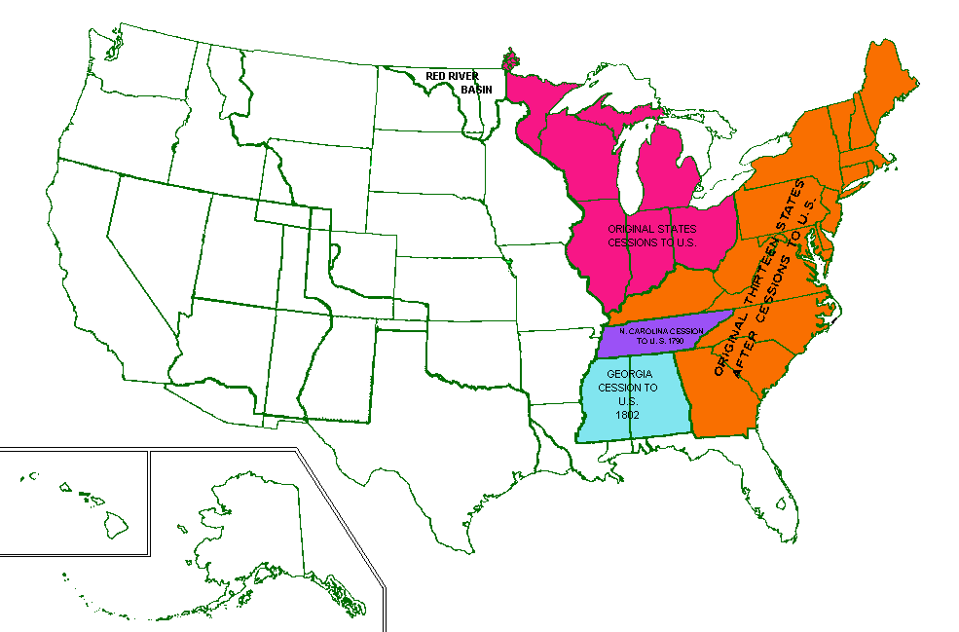

Slide 12
There shall be formed in the said territory, not less than three nor more than five States; and the boundaries of the States . . . whenever any of the said States shall have sixty thousand free inhabitants therein, such State shall be admitted . . . into the Congress of the United States, on an equal footing with the original States in all respects whatever, and shall be at liberty to form a permanent constitution and State government. . . .
The Northwest Ordinance, art. V (1787)

Slide 13
New States may be admitted by the Congress into this Union; but no new State shall be formed or erected within the Jurisdiction of any other State; nor any State be formed by the Junction of two or more States, or Parts of States, without the Consent of the Legislatures of the States concerned as well as of the Congress.
Admission of New States
Constitution, art. IV, § 3, clause 1

Slide 14
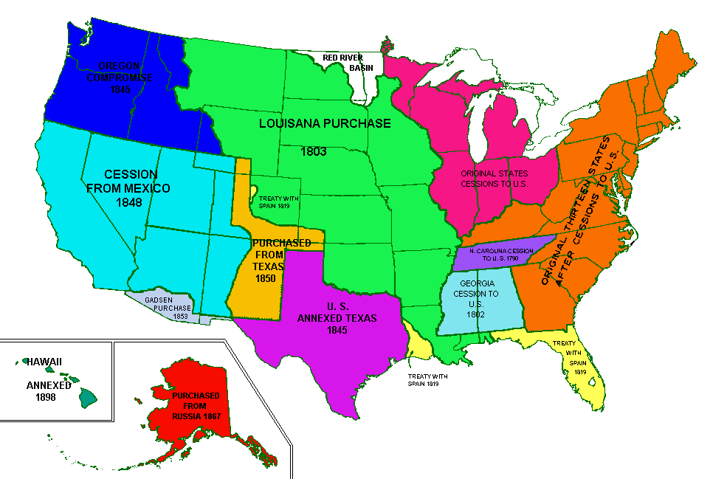

Slide 15
Pollard v. Hagan
44 U.S. 212 (1845)
p. 43

Slide 16
Pollard v. Hagan Timeline
Pollard
Hagan
1809: Bill Pollard applied to the Spanish Commandment of Mobile for a piece of land by the Mobile River
1816: Bill dies
1824: Act of Congress
1836: Act of Congress
1837: Pollard’s heirs receive patent from feds
1819: Alabama admitted to the Union
1823:
Curtis took possession of the land and filled it in
Pollard’s heir (Jim) ousts him and builds a blacksmith’s shop
Curtis gets the land back from Jim by a forcible entry/detainer proceeding
1845: Jim’s case trying to get Curtis off the land makes it to the Supreme Court

Slide 17
Ownership of the parcel
Feds
State of Alabama
This land belongs to Jim
Spanish gave the land to Bill
We approved that in 2 different acts of congress
We issued a patent to Jim
We have the right to dispose of all public lands in the state, so this was kosher.
This land was never federal land so the acts of Congress don’t matter.
Feds had not right to issue the patent
This land was underwater at the time Alabama entered the union so it belongs to Alabama

Slide 18
Article IV – The States
Section 1 - Each State to Honor all others
Full Faith and Credit shall be given in each State to the public Acts, Records, and judicial Proceedings of every other State. And the Congress may by general Laws prescribe the Manner in which such Acts, Records and Proceedings shall be proved, and the Effect thereof.
Section 2 - State citizens, Extradition
The Citizens of each State shall be entitled to all Privileges and Immunities of Citizens in the several States.
A Person charged in any State with Treason, Felony, or other Crime, who shall flee from Justice, and be found in another State, shall on demand of the executive Authority of the State from which he fled, be delivered up, to be removed to the State having Jurisdiction of the Crime.
Section 4 - Republican government
The United States shall guarantee to every State in this Union a Republican Form of Government, and shall protect each of them against Invasion; and on Application of the Legislature, or of the Executive (when the Legislature cannot be convened) against domestic Violence.

Slide 19
Article IV, Section 3- New States
Clause 1: The Admissions Clause
CLAUSE 2: The PROPERTY CLAUSE
New States may be admitted by the Congress into this Union; but no new States shall be formed or erected within the Jurisdiction of any other State; nor any State be formed by the Junction of two or more States, or parts of States, without the Consent of the Legislatures of the States concerned as well as of the Congress.
The Congress shall have Power to dispose of and make all needful Rules and Regulations respecting the Territory or other Property belonging to the United States; and nothing in this Constitution shall be so construed as to Prejudice any Claims of the United States, or of any particular State.

Slide 20
The Admissions Clause
New States may be admitted by the Congress into this Union; but no new State shall be formed or erected within the Jurisdiction of any other State; nor any State be formed by the Junction of two or more States, or Parts of States, without the Consent of the Legislatures of the States concerned as well as of the Congress.
Admission of New States
Constitution, art. IV, § 3, clause 1
[on an equal footing]

Slide 21
1802 Deed of Cession from Georgia
The object of all the parties to these contracts of cession, was to convert the land into money for the payment of the debt, and to erect new states over the territory thus ceded; and as soon as these purposes could be accomplished, the power of the United States over these lands, as property, was to cease.

Slide 22
All that part of Alabama which lies between the thirty-first and thirty-fifth degree of north latitude, was ceded by the state of Georgia to the United States, by deed bearing date the 24th day of April, 1802, which is substantially, in all its principles and stipulations, ….

Slide 25
Equal Footing Doctrine
“Alabama is entitled to the sovereignty and jurisdiction over all the territory within her limits, subject to the common law, to the same extent that Georgia possessed it before she ceded it to the United States.
To maintain any other doctrine is to deny that Alabama has been admitted into the union on an equal footing with the original states…”

Slide 26
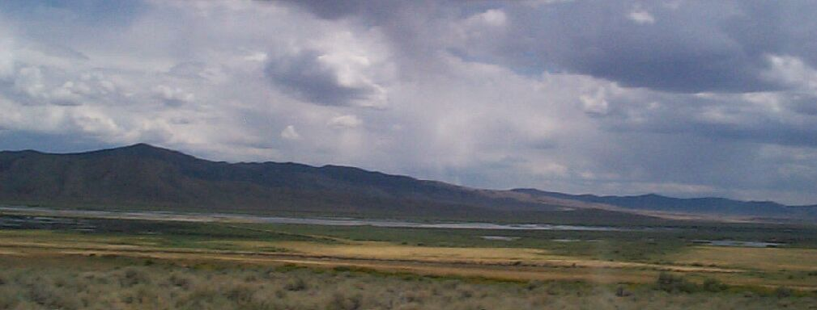
United States v. Gardner
107 F.3d 1314 (9th Cir. 1997)
p. 50

Slide 27
Who Owns the Land?
Federal Government
Feds got the land in the Treaty of Guadalupe Hidalgo in 1848
State Government
BUT, the Gardeners argue, Fed only got limited rights
Must hold land in trust for the creation of future states
Not entitled to keep the land for itself
On statehood, all the land should have gone to Nevada
Argument based on: cession terms

Slide 28
Article IV, Section 3- New States
CLAUSE 1: THE ADMISSIONS CLAUSE
CLAUSE 2: THE PROPERTY CLAUSE
New States may be admitted by the Congress into this Union; but no new States shall be formed or erected within the Jurisdiction of any other State; nor any State be formed by the Junction of two or more States, or parts of States, without the Consent of the Legislatures of the States concerned as well as of the Congress.
The Congress shall have Power to dispose of and make all needful Rules and Regulations respecting the Territory or other Property belonging to the United States; and nothing in this Constitution shall be so construed as to Prejudice any Claims of the United States, or of any particular State.

Slide 29
Equal Footing Doctrine
“When Alabama was admitted to the union, on an equal footing with the original states, she succeeded to all the rights of sovereignty, jurisdiction, and eminent domain which Georgia possessed at the date of the cession, except so far as this right was diminished by the public lands remaining in the possession and under the control of the United States, for the temporary purposes provided for in the deed of cession and the legislative acts connected with it.”

Slide 30
Equal Footing Doctrine Con’t.
“Supreme Ct has long held that the EFD refers to those attributes essential to a state’s equality in dignity and power with other states [and] a new state enters the Union in full equality with all the others”
No compacts between feds and new state that would limit political rights or obligations
Property agreements don’t count. Economic differences don’t count
EFD doesn’t get rid of all differences but establishes equality in terms of political standing and sovereignty

Slide 31
Land Grants to States

Slide 32
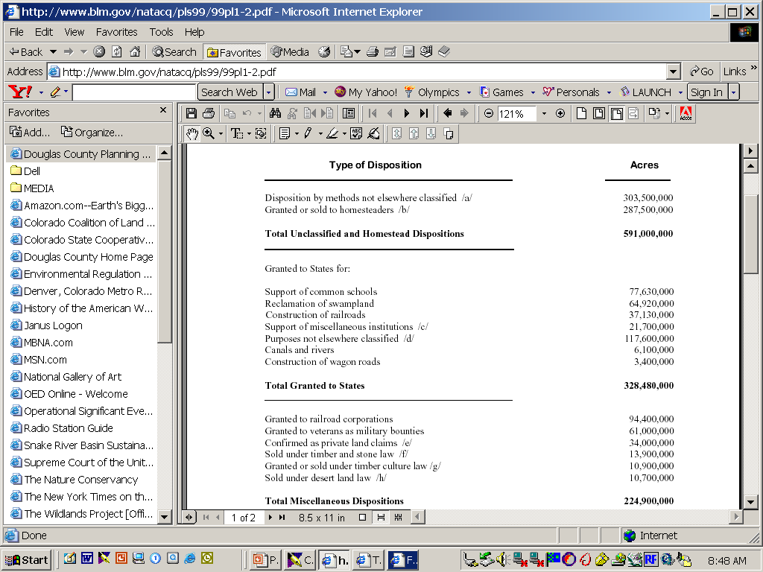
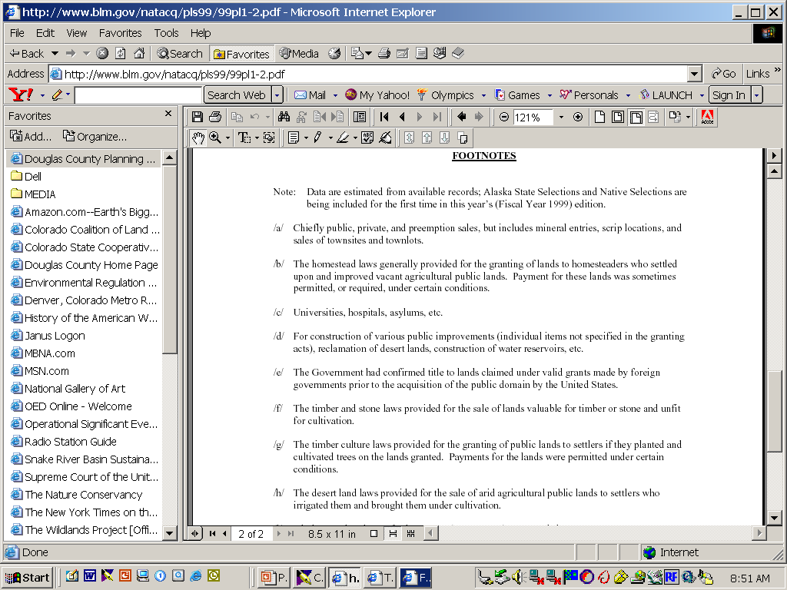
Source: BLM Public Land Statistics

Slide 33
Principal
Meridian
↓
T7N
T6N
T5N
Township 6 North
Range 6 East
(36 square miles)
T4N
T3N
R2W
R1W
T2N
R1E
R2E
R3E
R4E
R5E
R6E
R7E
R8E
T1N
Baseline→
T1S
T2S
T3S
Range and Township Lines

Slide 34
Grants to Private Parties

Slide 35
Uncle Sam’s Farm
Of all the mighty nations in the East or in the West, O this glorious Yankee nation is the greatest and the best. We have room for all creation and our banner is unfurled, Here's a general invitation to the people of the world.
Chorus: Then come along, come along, make no delay; Come from every nation, come from every way. Our lands, they are broad enough - don't be alarmed, For Uncle Sam is rich enough to give us all a farm. The brave in every nation are joining heart and hand And flocking to America, the real promised land; And Uncle Sam stands ready with a child upon each arm To give them all a welcome to a lot upon his farm.
A welcome, warm and hearty, do we give the sons of toil To come to the West and settle and labor on free soil; We've room enough and land enough, they needn't feel alarm - O! come to the land of freedom and vote yourself a farm.
http://www.youtube.com/watch?v=bwNsWz7O9yY

Slide 36
Far & Away Oklahoma Land Race
Great Land Dispersals
1862 The Homestead Act
1877 Desert Lands Act
1916 Stock-Raising Homestead Act of 1916
http://www.youtube.com/watch?v=5ycMhMM2UFs

Slide 37
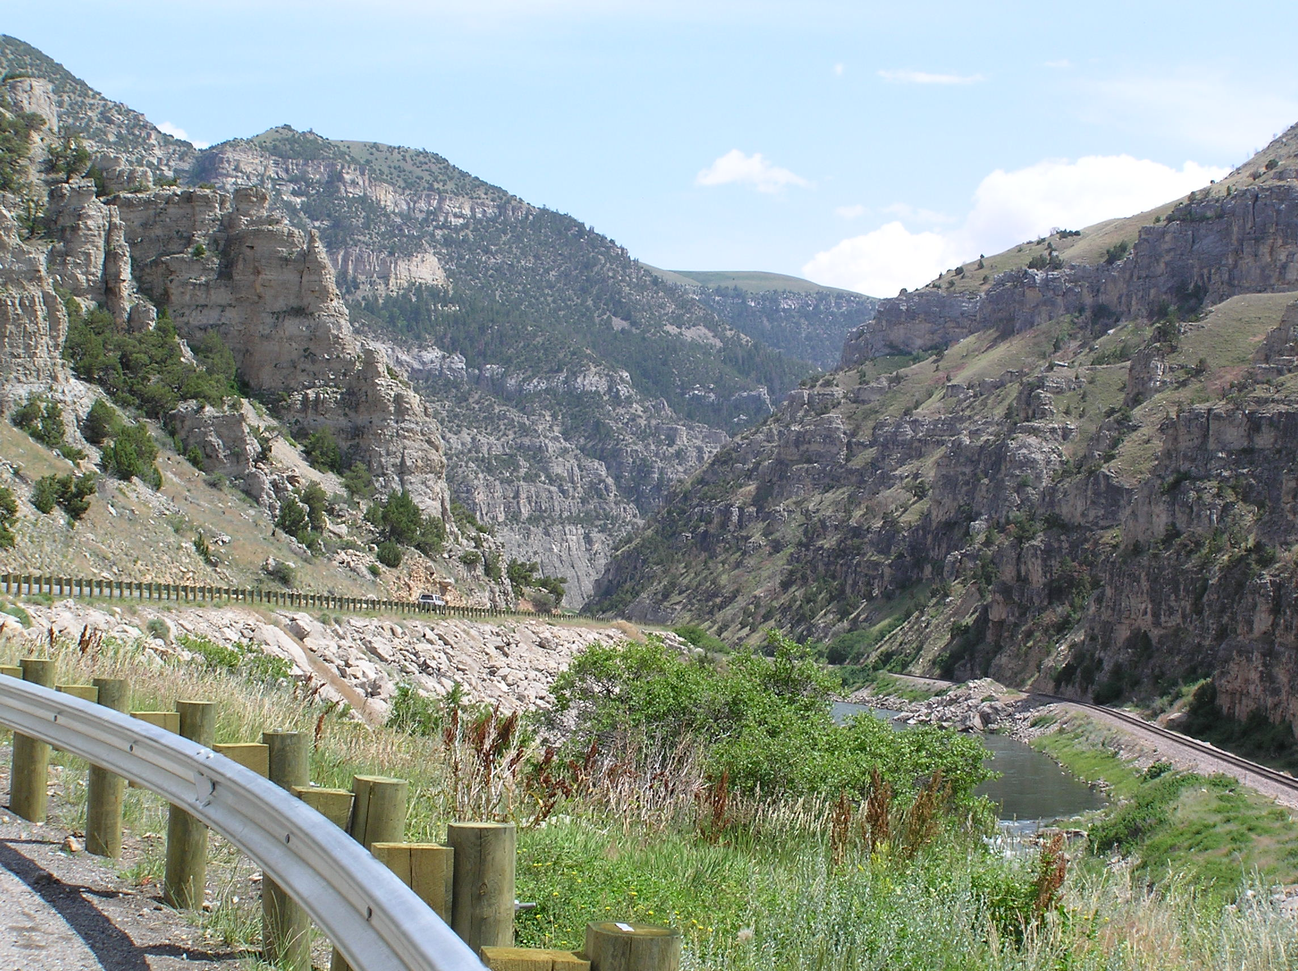
Foust v. Lujan
942 F.2d 712 (10th Cir. 1991)
p.66

Slide 38
Timeline
1863 Treaty with Eastern Band of Shoshone
1868 Treaty. Tribe agreed to switch lands.
1878. Feds moved another tribe onto the land too. (Northern Arapaho)
1905. Tribes ceded some land to the feds conditionally for the purpose of developing hydroelectric facilities.
1920 Supreme Ct holds that ceded lands remain Indian lands until all the conditions in the agreement have been fulfilled
1928. Feds opened up some of the ceded land to homesteading
1929 & 1930. Smith filed claims for land. He gets his patents and builds.
1934. Congress revokes power to sell additional Indian lands.
1939. Tribal ownership of all undisposed lands restored.
1979. survey shows that there were confused about the parcel

Slide 39
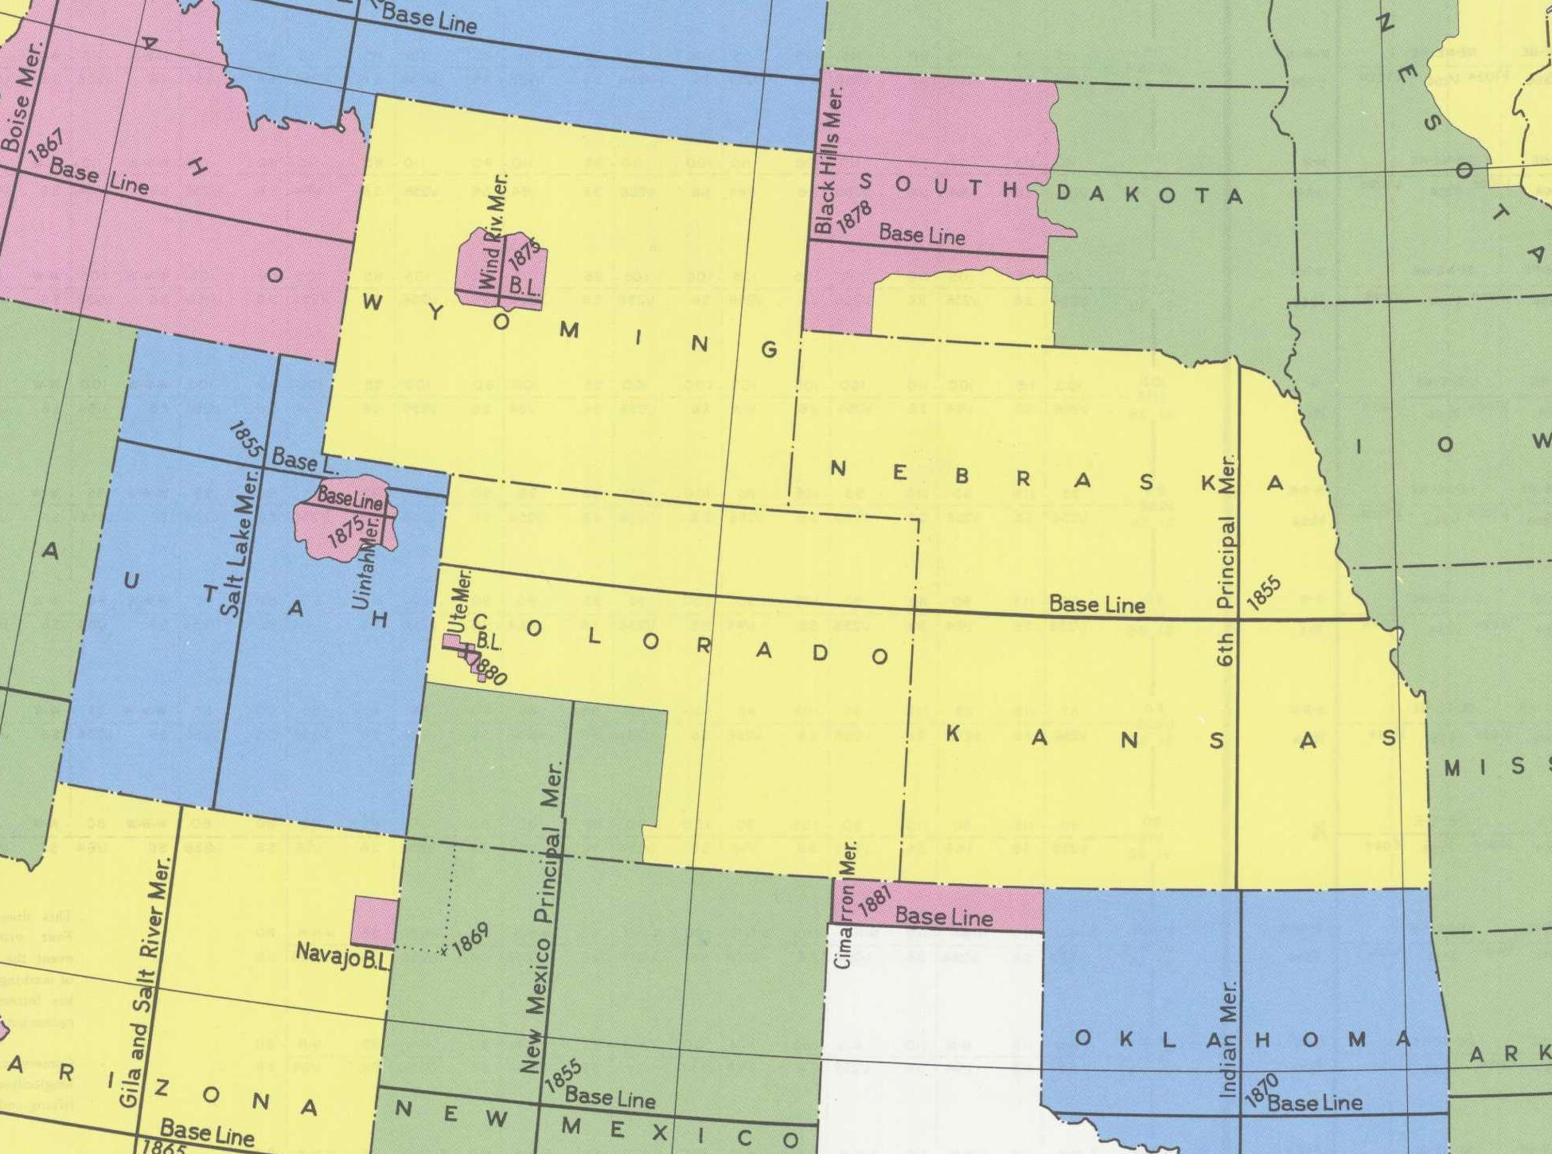
Source: Bureau of Land Management

Slide 40
1 mile
←
N.W. ¼
NW ¼
(160 Acres)
NW ¼
of NE ¼
NE ¼
of NE ¼
SW ¼
of NE ¼
40 acres
←1320 ft.→
SE ¼
of NE ¼
W ½
of SE ¼
NE ¼
of SE ¼
(40 acres)
SW ¼
SE ¼
of SE ¼
Enlargement of Section 28, Township 6N, Range 6E

Slide 41
1 mile
←
N.W. ¼
NW ¼
(160 Acres)
NW ¼
of NE ¼
NE ¼
of NE ¼
(40 acres)
SW ¼ of NE ¼
SE ¼
of NE ¼
W ½
of SE ¼
NE ¼of SE ¼
SW ¼
SE ¼
of SE ¼
Enlargement of Section 28, Township 6N, Range 6E

Slide 42
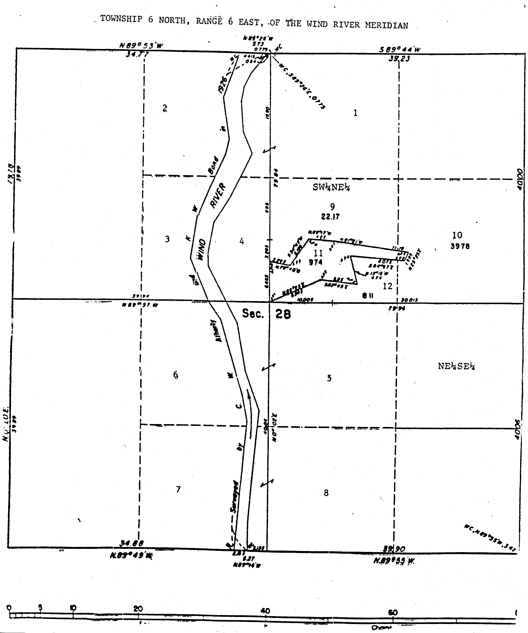
Source: Appendix to Petition for Writ of Certiorari in Northern Arapahoe and Shoshone Indian Tribes v. Foust

Slide 43
The Secretary [of the Interior] may correct patents or documents of conveyance . . . relating to the disposal of public lands where necessary in order to eliminate errors. In addition, the Secretary may make corrections of errors in any documents of conveyance which have heretofore been issued by the Federal Government to dispose of public lands.
43 U.S.C. § 1746

Slide 44
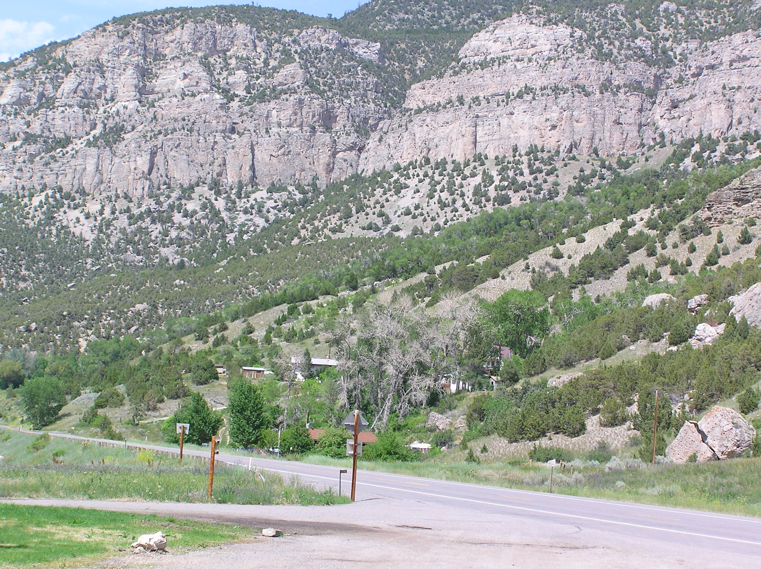
Wind River Canyon, Wyoming
Source: Federico Cheever

Slide 45
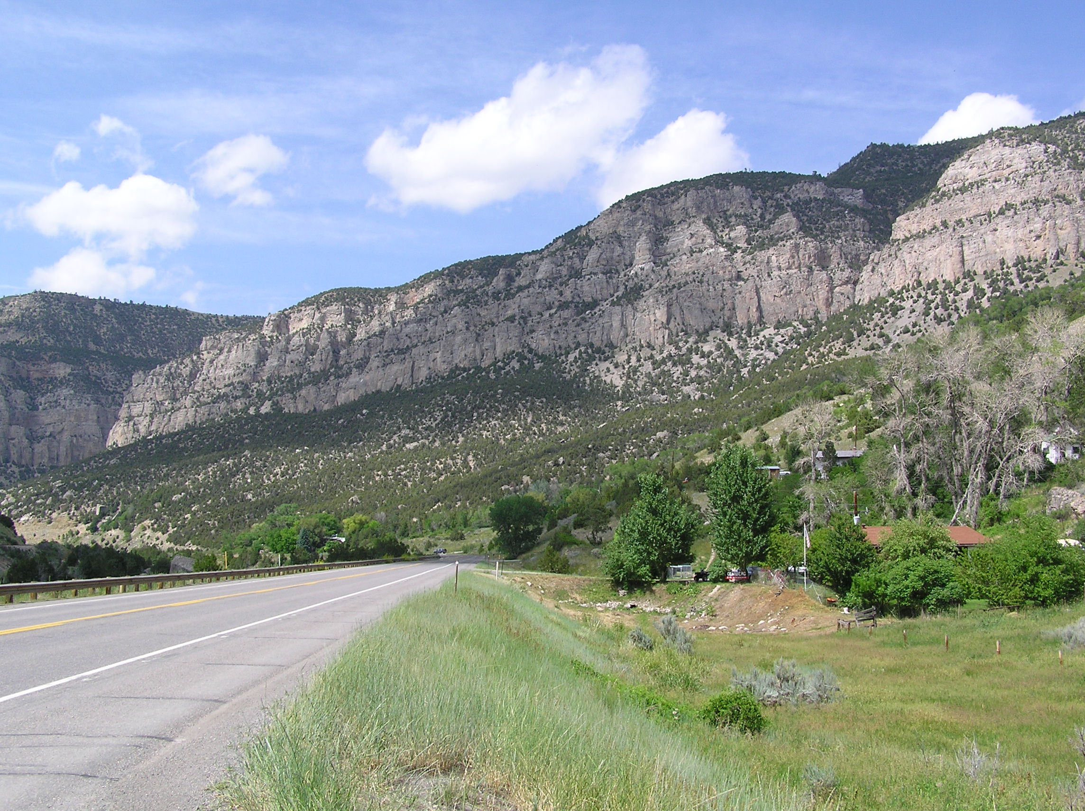
Wind River Canyon, Wyoming
Source: Federico Cheever

Slide 46
Discussion Problem
Nye County, Nevada

Slide 47
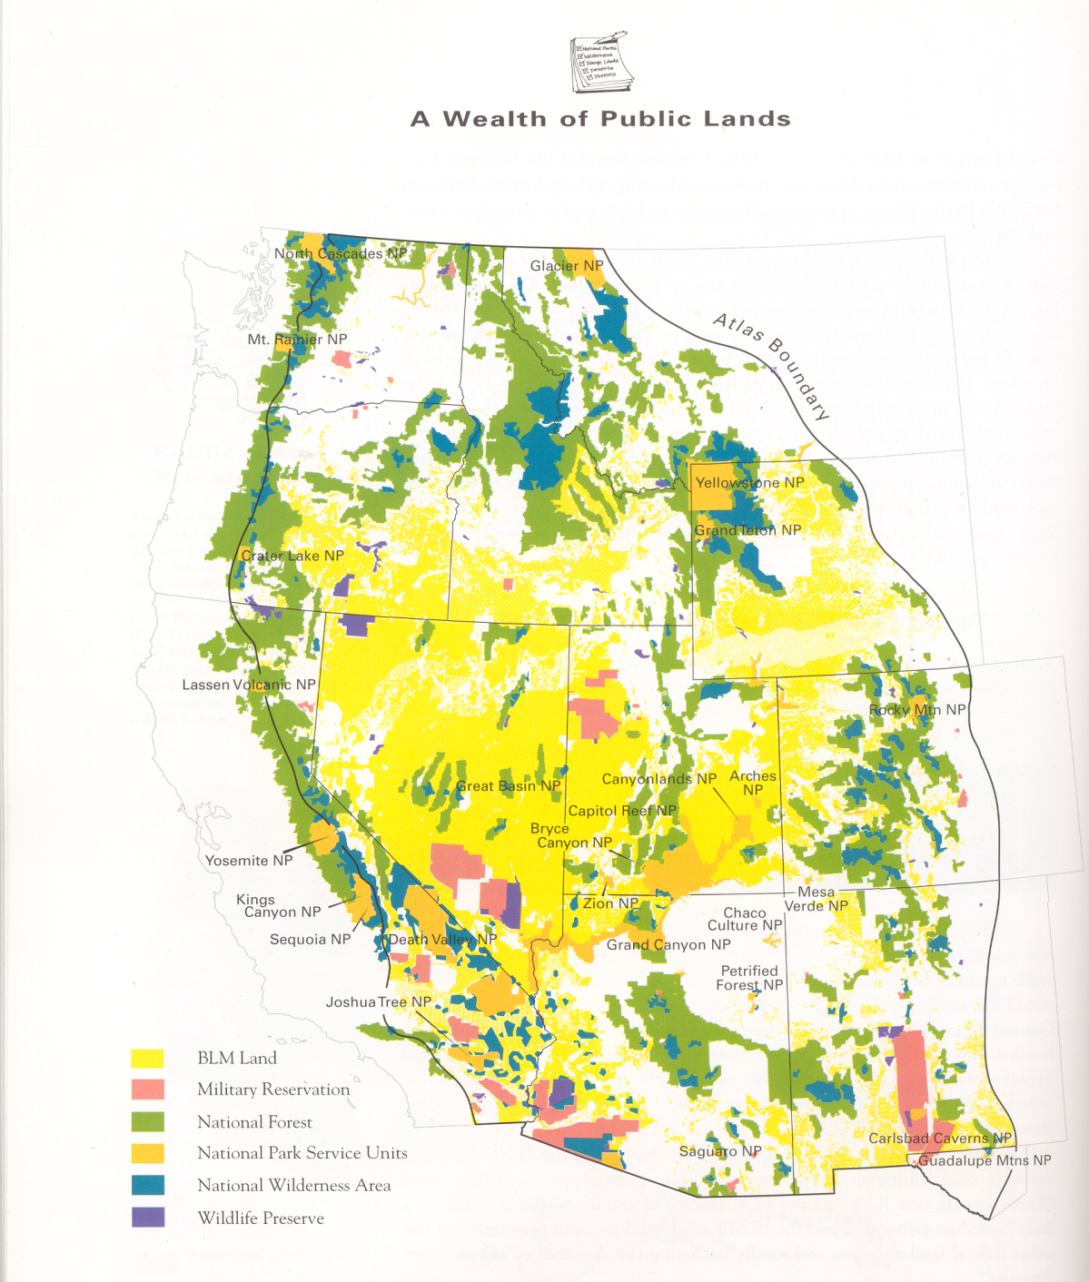
University of Colorado Center of American West,
Atlas of the New West (William E. Riebsame, General Editor)

Slide 48
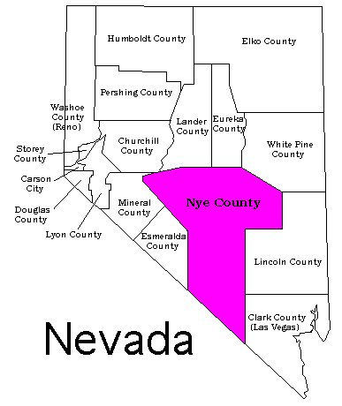

Slide 49
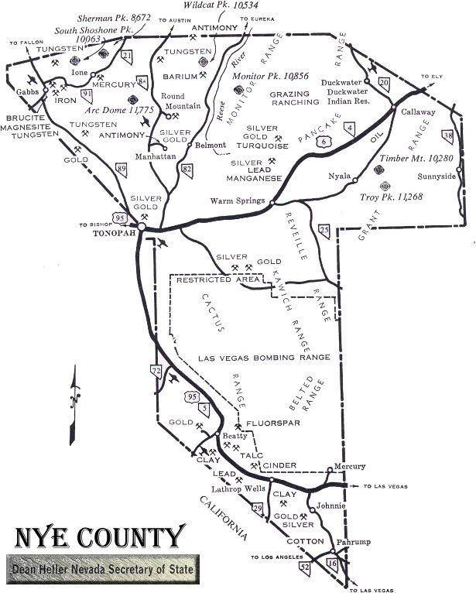
aa

Slide 50
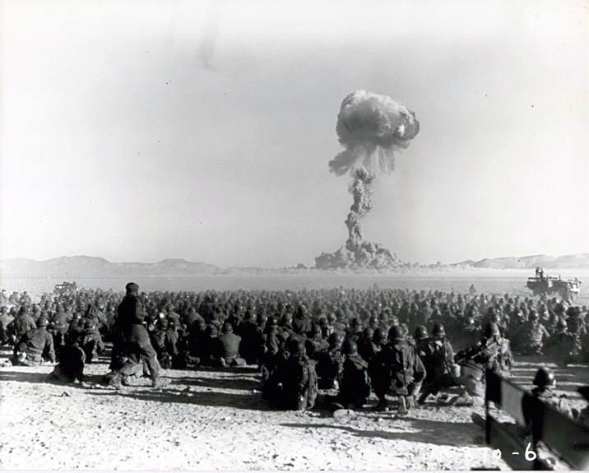
1951 Nuclear Detonation, Nevada.
Source: State of Nevada Division of Environmental Protection

