Slide 1
Natural Resources
Class #15
April 3, 2018

Slide 2
Constitutional Foundations of Wildlife Law
The Treaty Power

Slide 3
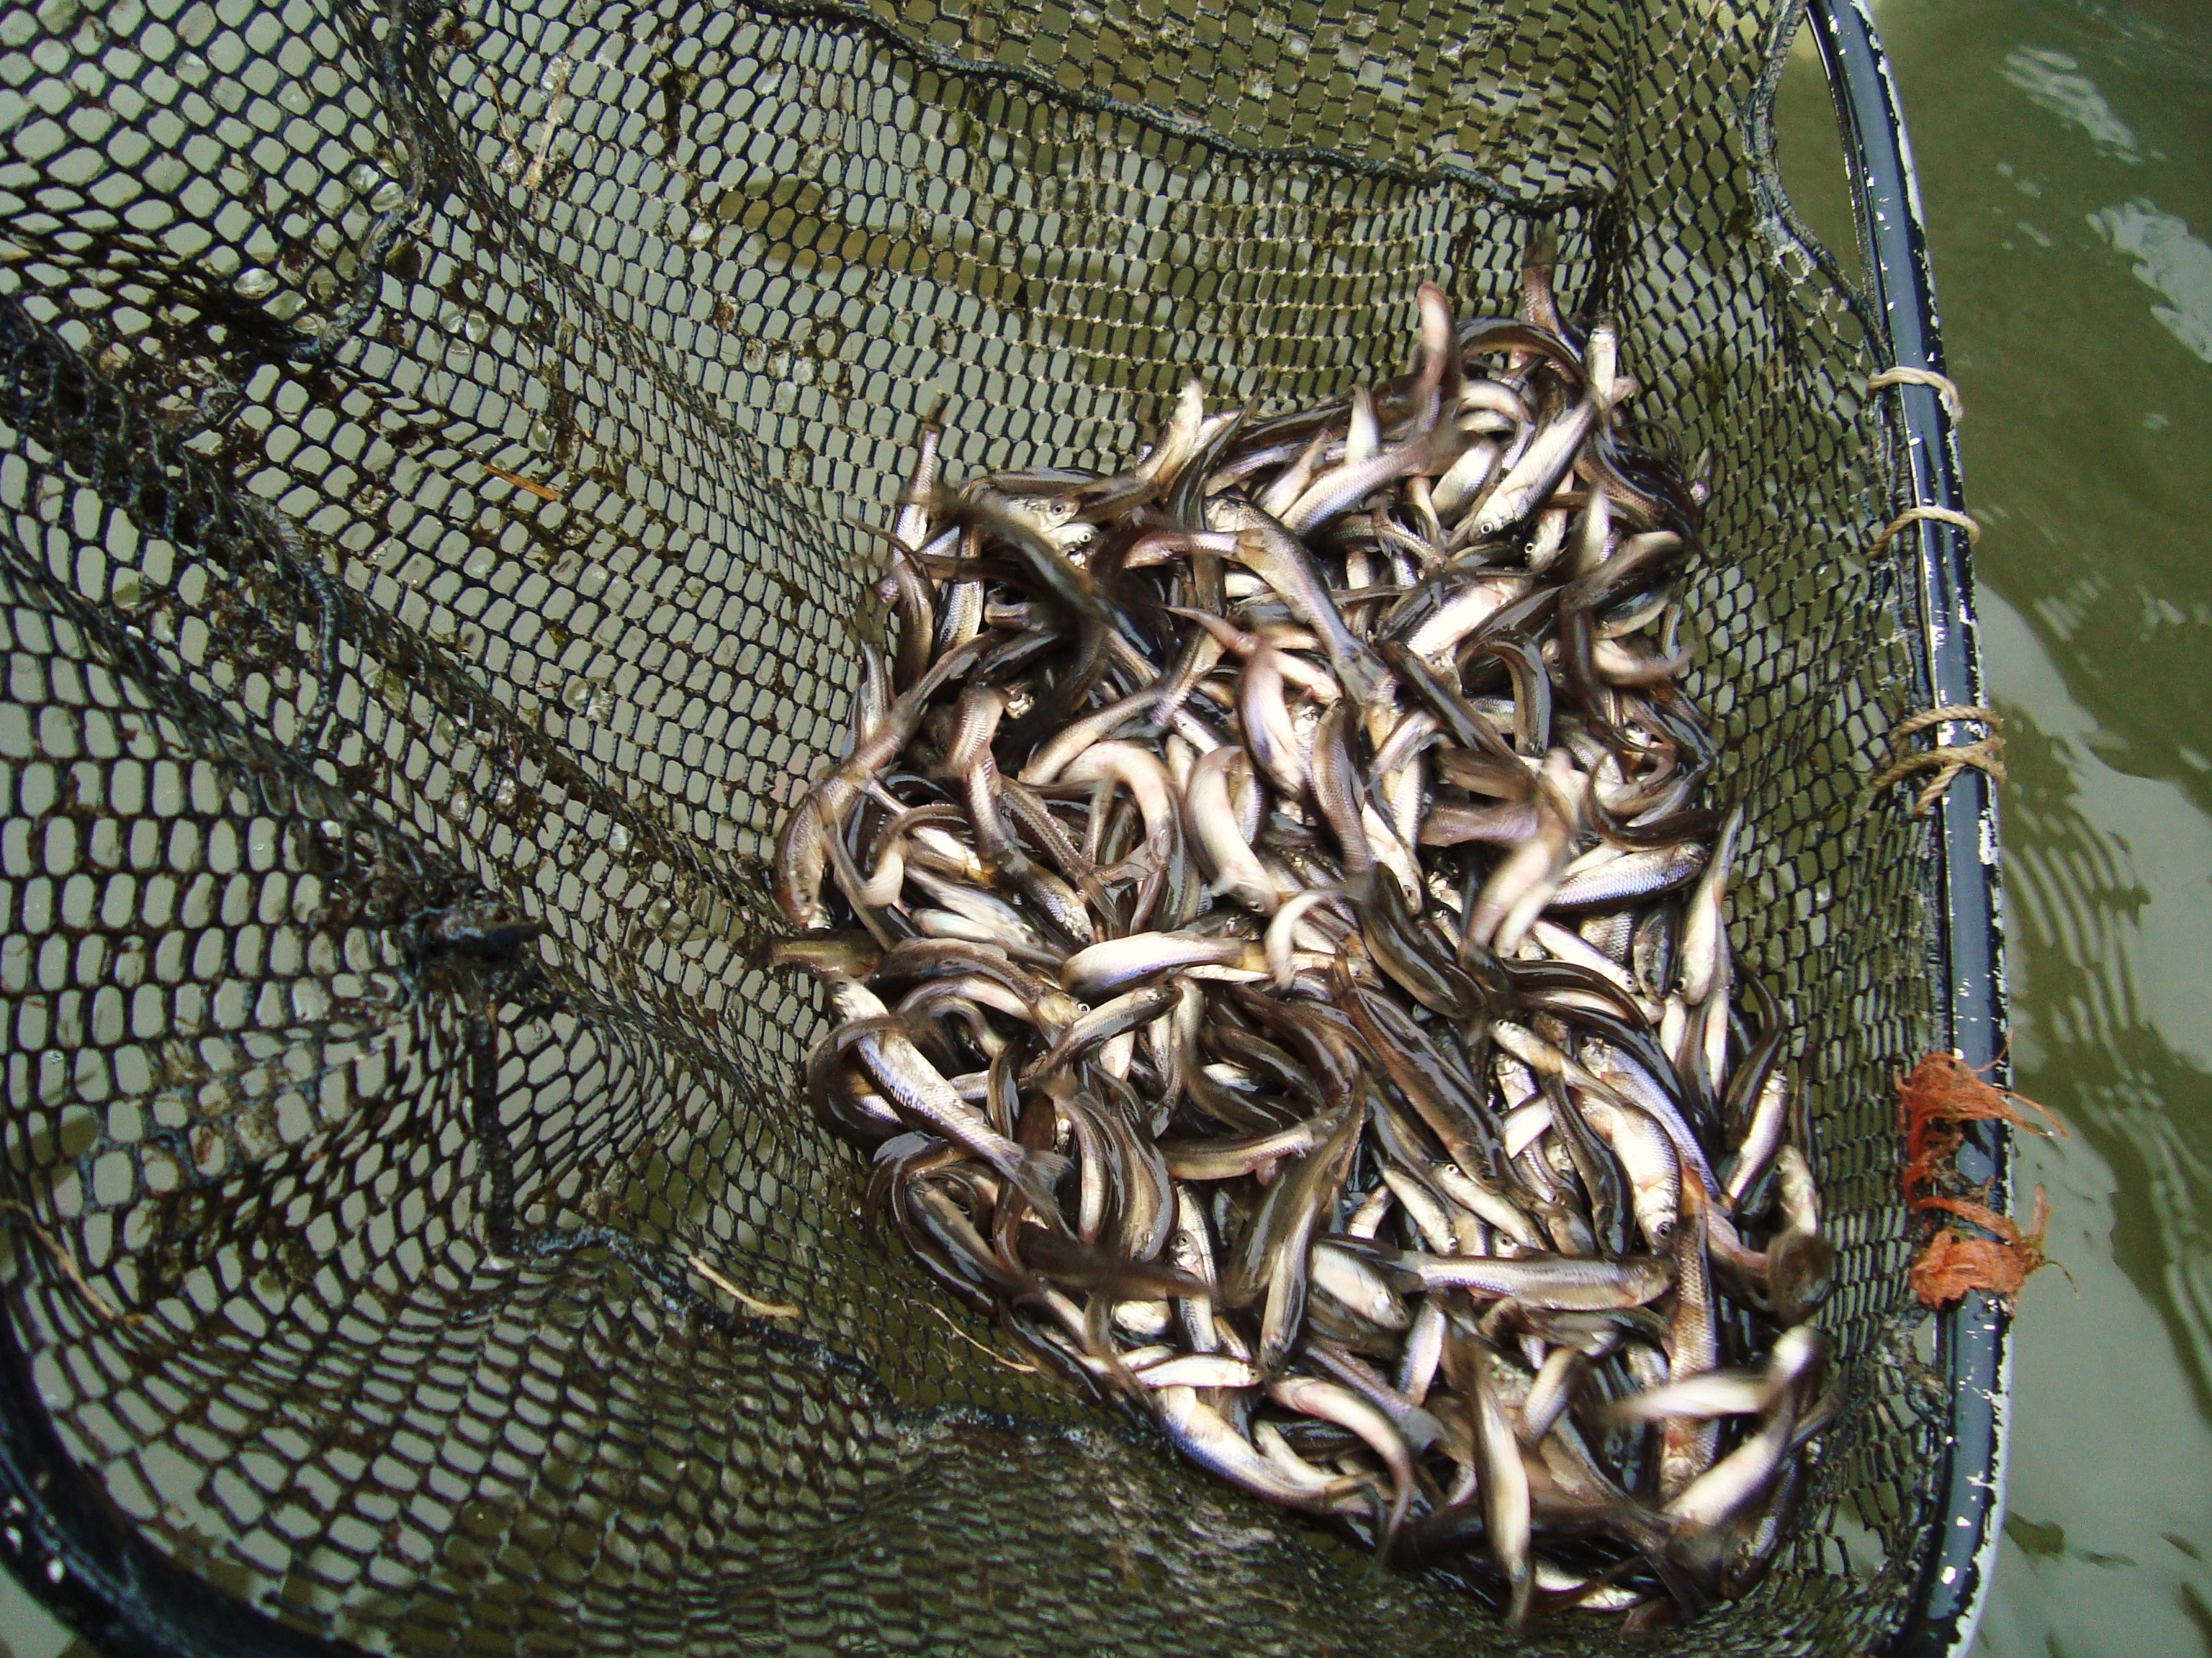
Hughes v. Oklahoma
551 U.S. 322 (1979)
p. 757

Slide 4
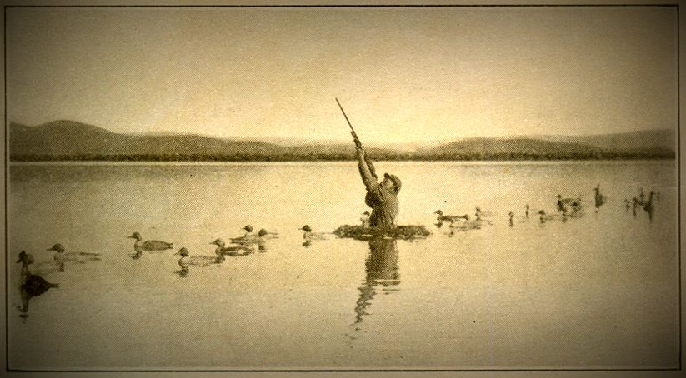
Missouri v. Holland
252 U.S. 416 (1920) (Holmes, J.) p. 758

Slide 5
The Treaty Power
Article II: The Executive Branch
Section II: He shall have Power, by and with the Advice and Consent of the Senate, to make Treaties, provided two thirds of the Senators present concur
PLUS Article VI:
This Constitution, and the Laws of the United States which shall be made in Pursuance thereof; and all Treaties made, or which shall be made, under the Authority of the United States, shall be the supreme Law of the Land; and the Judges in every State shall be bound thereby, any Thing in the Constitution or Laws of any State to the Contrary notwithstanding.
Supremacy Clause

Slide 6
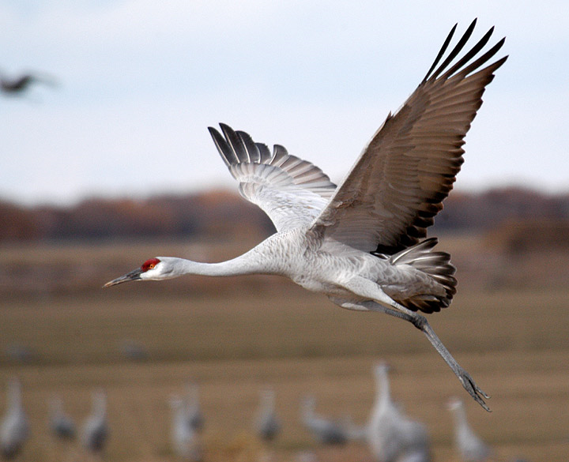

Slide 7
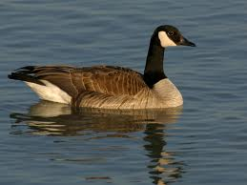
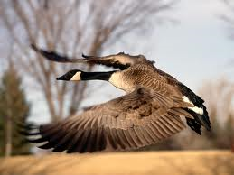
Migratory Bird Treaty Act of 1918
1916 Treaty with GB
Why protect these birds?
Food and because they a good at eating bugs that we don’t like
What does the Act do?
Prohibits killing, capturing or selling covered birds
Includes alive and dead birds plus bird parts (feathers, eggs, etc.)

Slide 8
The Treaty Power versus the 10th Amendment
“It is said that a treaty cannot be valid if it infringes the Constitution, that there are limits, therefore, to the treaty-making power, and that one such limit is that what an act of Congress could not do unaided, in derogation of the powers reserved to the States, a treaty cannot do.”

Slide 9
“We do not mean to imply that there are no qualifications to the treaty-making power; but they must be ascertained in a different way. It is obvious that there may be matters of the sharpest exigency for the national well being that an act of Congress could not deal with but that a treaty followed by such an act could, and it is not lightly to be assumed that, in matters requiring national action, “a power which must belong to and somewhere reside in every civilized government” is not to be found. . . .”

Slide 10
“To put the claim of the State upon title is to lean upon a slender reed. Wild birds are not in the possession of anyone; and possession is the beginning of ownership. The whole foundation of the State’s rights is the presence within their jurisdiction of birds that yesterday had not arrived, tomorrow may be in another State and in a week a thousand miles away. . .
Here a national interest of very nearly the first magnitude is involved. It can be protected only by national action in concert with that of another power.”

Slide 11
Constitutional Foundations of Wildlife Law
The Commerce Clause

Slide 12
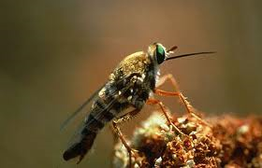
The Commerce Clause
Article I – The Legislative Branch
Section 8 – Powers of Congress
Clause 3 - To regulate Commerce with foreign Nations, and among the several States, and with the Indian Tribes;
Protection of Endangered Species
National Association of Home Builders v. Babbitt, 130 F.3d 1041 (D.C. Cir. 1997)
Delhi Sands Flower-Loving Fly
Lopez Test
Channels of interstate commerce
Instrumentalities
Substantial relationship

Slide 13



U.S. Fish and Wildlife Service
Created in 1940
Manages the Refuge System
95 million acres
No guidelines or organic act until 1997
Administers Wildlife Programs
Mission is to administer lands for “the conservation, management and where appropriate, restoration of the fish, wildlife and plant resources and their habitats .. For the benefit of present and future generations…”

Slide 14
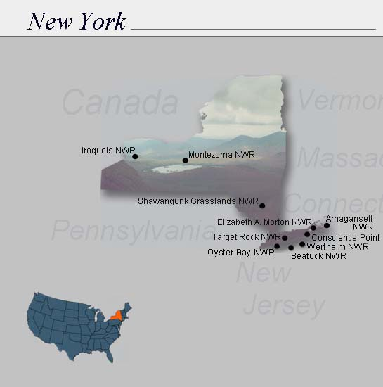

Slide 15

Gibbs v. Babbitt
214 F.3d 483 (4th Cir. 2000) (Wilkinson, C.J.)
P. 769

Slide 16
50 C.F.R. 17.84(c)
Taking allowed if not intentional or willful or is defense of a person’s life
Taking allowed where wolves are in the act of killing livestock or pets
Can use nonlethal methods of harassment on private property
Can take where you have permission in writing from the FWS
24-hour reporting Requirement

Slide 17
Rancho Viejo, LLC v. Norton
323 F.3d 1062 (D.C. Cir. 2003) (Garland, J.) p. 774

Slide 18
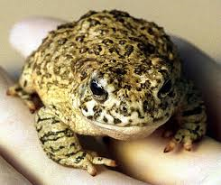


Which of these is the article of commerce?

Slide 19
The Endangered Species Act of 1973

Slide 20
ESA § 2: Congressional Findings and Declarations of Purposes and Policy
(a) Findings
The Congress finds and declares that--
Various species … have been rendered extinct as a consequence of economic growth and development untempered by an adequate concern and conservation
These species are of esthetic, ecological, education, historical, recreational, and scientific value
(b) Purposes
The purposes of this chapter are to provide a means whereby the ecosystems upon which endangered species and threatened species depend may be conserved, to provide a program for the conservation of such endangered species and threatened species . . .

Slide 21
ESA § 3: Definitions
For the purposes of this chapter . . .
(3) The terms “conserve,” “conserving,” and “conservation” mean to use and the use of all methods and procedures which are necessary to bring any endangered species or threatened species to the point at which the measures provided pursuant to this chapter are no longer necessary. . . .

Slide 22


According to the Department of the Interior, there may be more than 100 species of fish and wildlife which are presently threatened with extinction within the United States.
H.R. No. 93-412 (1973)
“This legislation provides the Federal Government with the needed authority to protect an irreplaceable part of our national heritage – threatened wildlife.”
Richard Nixon

Slide 23

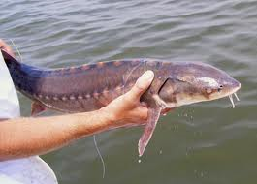
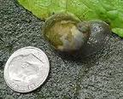
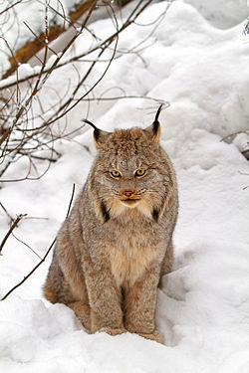
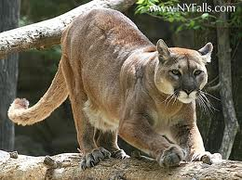
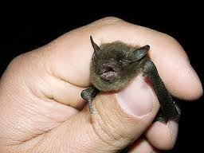

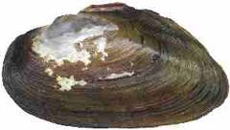

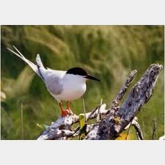
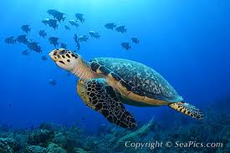
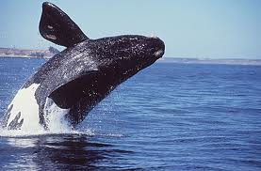
Sturgeon, shortnose
Butterfly, Karner blue
Snail, Chittenango ovate amber
Bat, Indiana
Canada Lynx
Leedy’s Roseroot
Wedgemussel, dwarf
Puma, eastern
Sandplain Gerardia
Roseate Tern
Sea turtle, hawksbill
Whale, right

Slide 24
ESA § 3: Definitions
(15) The term “Secretary” means, except as otherwise herein provided, the Secretary of the Interior or the Secretary of Commerce as program responsibilities are vested pursuant to the provisions of Reorganization Plan Numbered 4 of 1970 . . . .

Slide 25


Slide 26

National Marine Fisheries Service, United States Department of Commerce
Source: www.nmfs.noaa.gov

Slide 27
The Endangered Species Act
Listing Under Section 4
(Deciding What to Protect)

Slide 28
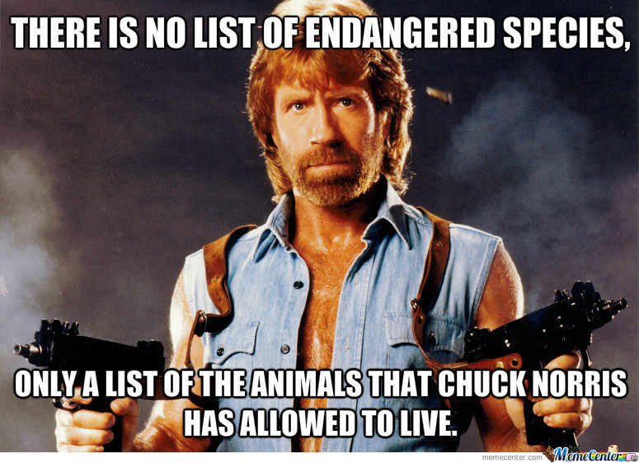

Slide 29
ESA Section 4 - Listing
The Secretary shall by regulation… determine whether any spp is an endangered or threatened spp because of any of the following factors:
The present or threatened destruction, modification, or curtailment of its habitat or range;
Overutilization for commercial, recreational, scientific, or educational purposes;
Disease or predation;
The inadequacy of existing regulatory mechanisms; or
Other natural or manmade factors affecting its continued existence

Slide 30
Section 4 – Critical Habitat
(3) (A) the Secretary, … to the maximum extent prudent and determinable—
shall, concurrently with making a [listing determination], designate any habitat of such species which is then considered to be critical habitat; and
May from time-to-time thereafter as appropriate, revise such designation

Slide 31
Section 4(b) – Basis for Listing
(1)(A) The Secretary shall make [listing determinations] solely on the basis of the best scientific and commercial data available to him after conducting a review of the status of the species and after taking into account those efforts, if any, being made by any State or foreign nation, … to protect such species…

Slide 32
Section 4(b) – Basis for CH designation
(2) The Secretary shall designate CH … on the basis of the best scientific data available after taking into consideration the economic impact, the impact on national security, and any other relevant impact, of specifying a particular area as critical habitat.

Slide 33
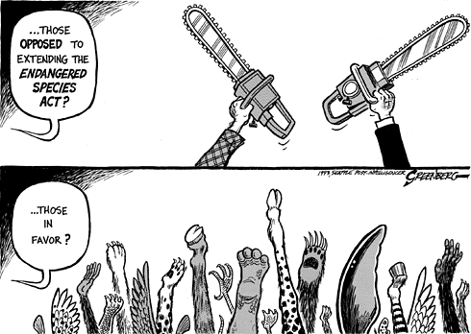
Other Elements of Section 4
4(d) rules regarding threatened species
4(f) recovery plans
4(g) monitoring

Slide 34
Western Watersheds Project v. U.S. Fish and Wildlife Service
535 F. Supp. 2d 1171 (D. Idaho 2007) (Winwill, C.J.)
p. 788

Slide 35
ESA 4(b)(3) [p.783]
(A) To the maximum extent practicable, within 90 days after receiving the petition of an interested person… to add a species to, or to remove a species from either of the lists … the Sec’y shall make a finding as to whether the petition presents substantial scientific or commercial information indicating that the petitioned action may be warranted. If such a petition is found to present such information, the Sec’y shall promptly commence a review of the status of the species concerned. The Sec’y shall promptly publish each finding …

Slide 36
ESA 4(b)(3)
(B) Within 12 months after receiving a petition … [and determining that a the petitioned action may be warranted], the Sec’y shall make one of the following findings:
(i) the petitioned action is not warranted
(ii) the petitioned action is warranted, in which case the Sec’y shall promptly publish in the Federal Register a general notice and the complete text of a proposed regulation to implement such action…
(iii) the petitioned action is warranted but … precluded [so they get another 12 months]

Slide 37
Section 4 Listing Petition
4(b)(3)(B) INITIAL LISTING DECISION
LISTING PETITION
90 DAYS
12 MONTHS
LISTING WARRANTED
LISTING NOT
WARRANTED
4(b)(3)(A) SUBSTANTIAL INFORMATION DETERMINATION
LISTING WARRANTED
BUT
PRECLUDED

Slide 38
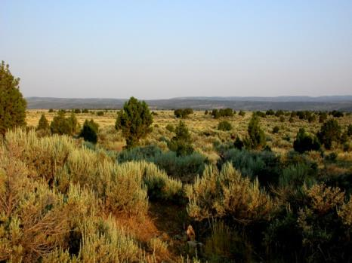
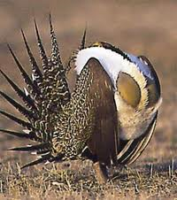
Greater Sage Grouse

Slide 39

Source: Erin Robertson
http://rockymountainwild.org/_site/wp-content/uploads/threeforks_gsg-habitat_

Slide 40
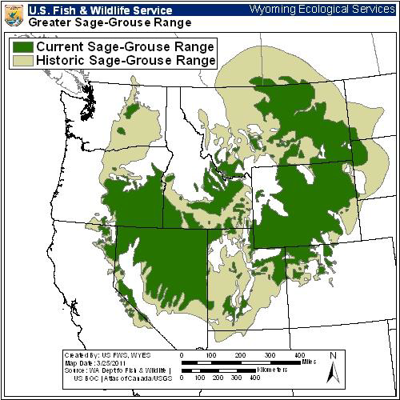
Greater Sage Grouse – U.S. FWS

Slide 41
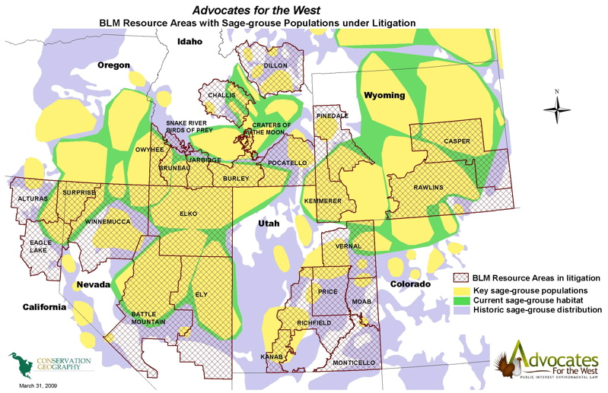

Slide 42
The Listing Process for Sage Grouse
Western Watersheds Project petitions for listing the Sage Grouse
Triggers the 90-day review 4(b)(3)(A) to determine whether listing may be warranted
Secretary decides that it may be warranted
Triggers the 12-month determination 4(b)(3)(B)
“best scientific and commercial data”

Slide 43
ESA § 4 : Determination of Endangered Species and Threatened Species
(b) Basis for determinations
(1)(A) The Sec’y shall make determinations … solely on the basis of the best scientific and commercial data available … after conducting a review of the status of the species and after taking into accounts those efforts, if any, being made by any State or foreign nation …

Slide 44
Use your 100 points to determine likelihood of extinction
2011-2016 [next 5 years]→ 10
2021-2031 [5-10 years] → 40
2032-2046 [10-25 years] → 40
2046- 2061 [25-50 years] → 10
2062-2111 [50-100 years] → 0
2112-2212 [100-200 years] → 0

Slide 45
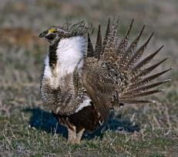
July 2002, March 2003, December 2003 – Petitions to List
April 2004 – 90-Day Finding
January 2005 – “Not Warranted” 12-Month Finding
December 2007 - Court Overturned “Not Warranted” Finding
March 2010 – “Warranted, But Precluded” Finding
2011 settlement agreement requires a decision by 9/30/16

Slide 46
ESA 4(b)(5)
With respect to any regulation proposed by the Sec’y …, the Sec’y shall—
(A) not less than 90 days before the effective date of the regulation-
[give notice to State, County, Foreign Nations, Scientific organizations, and put something in the newspaper]
(E) promptly hold one public hearing n the proposed regulation if any person files a request for such a hearing within 45 days after the fate of publication of the general notice

Slide 47
ESA 4(b)(6)
(A) within the one-year period beginning on the date on which the general notice is published in accordance with (5)(A)(i) … , the Sec’y shall publish
(i) if a determination as to whether a species is an endangered species, or a revision of critical habitat is involved, either –
(I) a final regulation to implement such determination
(II) a final regulation to implement such revision or a finding that such revision should not be made
(III) notice of a one-year extension
(IV) notice that the proposed reg is being withdrawn (along with why)

Slide 48
Section 4 Listing Rulemaking
NOTICE OF PROPOSED RULE 4(b)(5)(A)
12 MONTHS
NOTICE OF
FINAL RULE
4(b)(6)(A) = LISTING
NOTICE OF WITHDRAWAL
4(b)(6)(A)
NOTICE OF 6 MO. EXTENSION 4(b)(6)(B)(i)

