Slide 1
Natural Resources
Class #16
April 5, 2018

Slide 2
The Endangered Species Act
Consultation, Jeopardy, and Adverse Modification Under Section 7

Slide 3
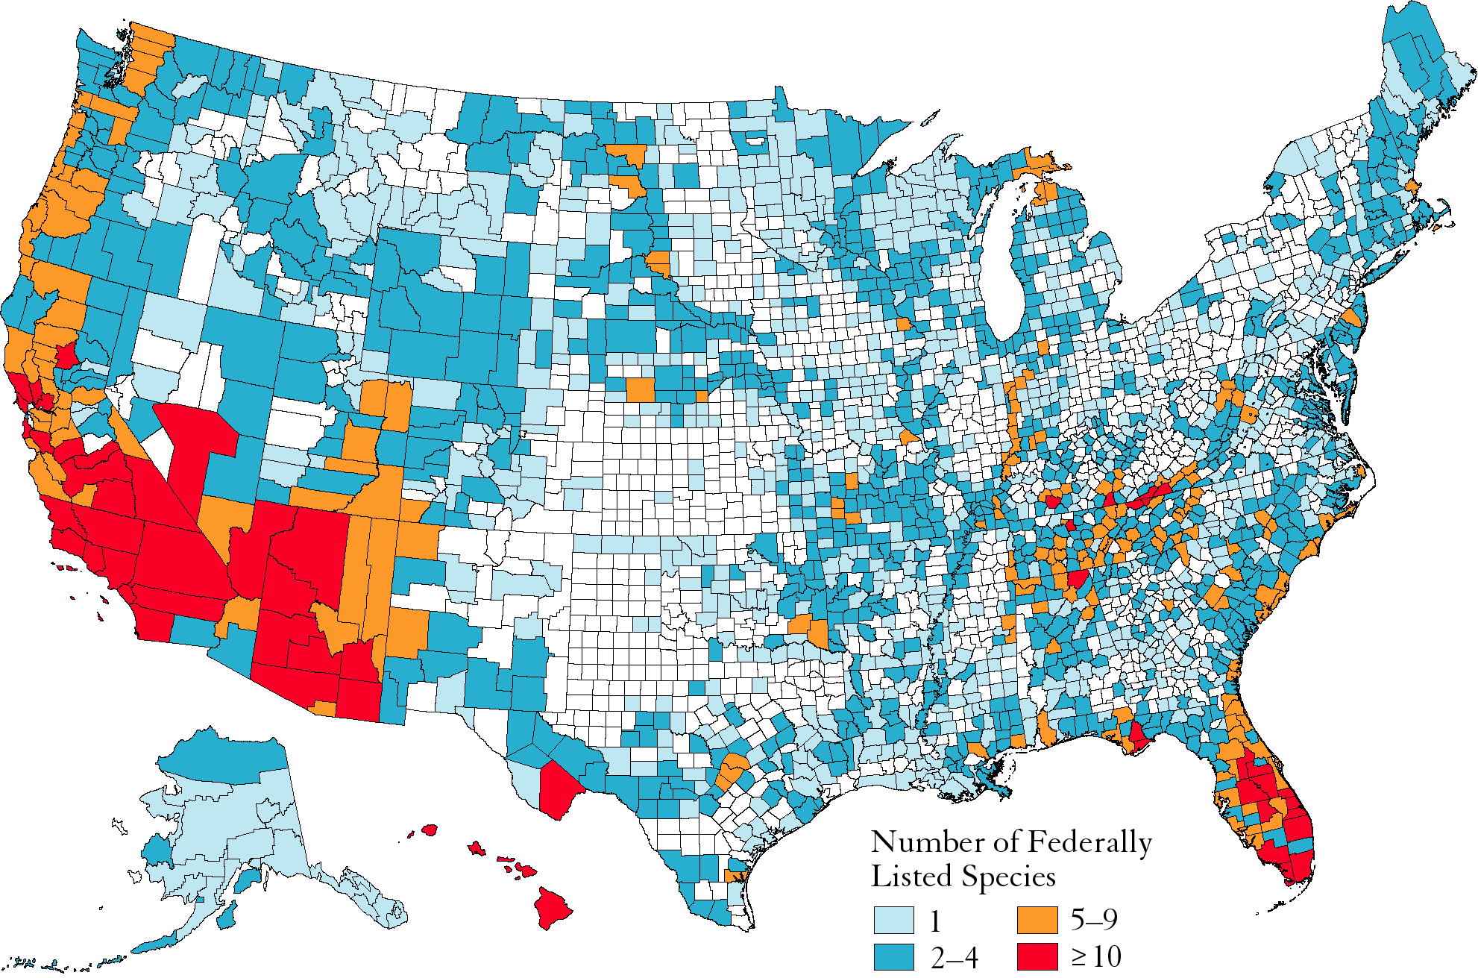
County Distribution of Federally Listed Species

Slide 4
Section 4 Listing Petition
4(b)(3)(B) INITIAL LISTING DECISION
LISTING PETITION
90 DAYS
12 MONTHS
LISTING WARRANTED
LISTING NOT
WARRANTED
4(b)(3)(A) SUBSTANTIAL INFORMATION DETERMINATION
LISTING WARRANTED
BUT
PRECLUDED

Slide 5
Listing RUlemaking
Listing is warranted, now what?

Slide 6
Section 4 Listing Rulemaking
NOTICE OF PROPOSED RULE 4(b)(5)(A)
12 MONTHS
NOTICE OF
FINAL RULE
4(b)(6)(A) = LISTING
NOTICE OF WITHDRAWAL
4(b)(6)(A)
NOTICE OF 6 MO. EXTENSION 4(b)(6)(B)(i)

Slide 7
Tennessee Valley Authority v. Hill
437 U.S. 153 (1978)(Burger, C.J.)
p. 819
http://www.oyez.org/cases/1970-1979/1977/1977_76_1701

Slide 8
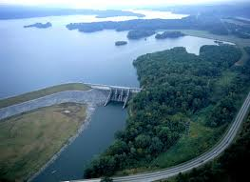
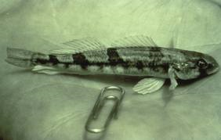
The Dam versus the Darter
1973: Congress passed the ESA
1973: Eitner discovered the snail darter, a small tannish fish
1975: FWS lists the snail darter as endangered (amended complaint in ongoing NEPA action adds ESA claim)
1966: Congress authorized the dam.
1967: Construction began

Slide 9
16 U.S.C. § 1536 [ESA Section 7]
Interagency Cooperation
Federal agency actions and consultation
  (2) Each Federal agency shall, in consultation with and with the assistance of the Secretary, insure that any action authorized, funded, or carried out by such agency (hereinafter in this section referred to as an “agency action”) is not likely to jeopardize the continued existence of any endangered species or threatened species or result in the destruction or adverse modification of habitat of such species which is determined by the Secretary, after consultation as appropriate with affected States, to be critical. . . .

Slide 10
Discussing ESA section 7 (holding #1)
One would be hard pressed to find a statutory provision whose terms were any plainer than those of §7. Its very words affirmatively command all federal agencies “to insure that actions authorized, funded, or carried out by them do not jeopardize the continued existence” of an endangered species or “result in the destruction or modification of habitat of such species…” This language admits of no exception.

Slide 11
Discussing Remedies (holding #2)
Congress has spoken in the plainest of words, making it abundantly clear that the balance has been struck in favor of affording endangered species the highest of priorities, thereby adopting a policy which it described as “institutionalized caution.”

Slide 12
Powell’s Dissent
Section 7 cannot reasonably be interpreted as applying to a project that is completed or substantially completed when its threat to an endangered species is discovered.
Absurd result
Does not accord with “some modicum or common sense and the public weal”

Slide 13
Rehnquist’s Dissent
The Act did not prohibit the District Court from refusing, in its exercise of its traditional equitable powers, to enjoin petitioner from completing the dam.

Slide 14
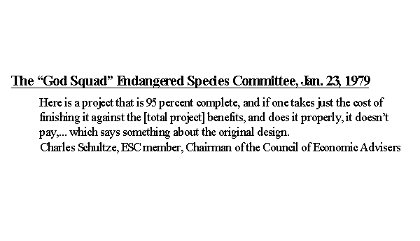

Slide 15
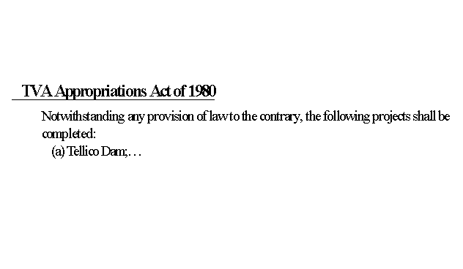

Slide 16
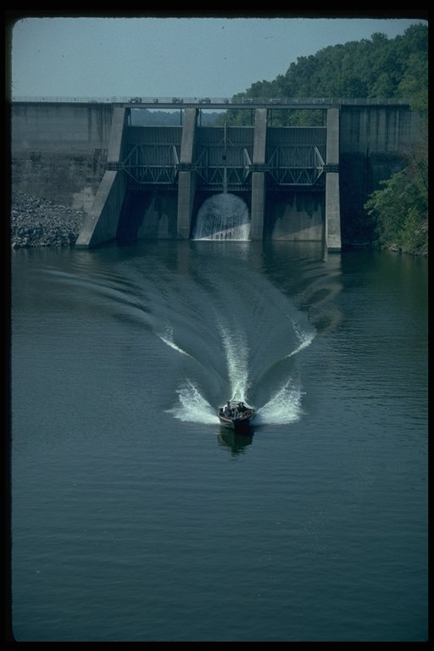

Slide 17

Consultation
Section 7 (a) Federal agency actions and consultation
(2) Each Federal agency shall, in consultation with and with the assistance of the Secretary, insure that any action authorized, funded, or carried out by such agency … is not likely to jeopardize the continued existence of any [listed] species or result in the destruction or adverse modification of habitat of such species which is … critical. . . .

Slide 18
BiOp
7(b)(3): “Promptly after the conclusion of consultation,” the Sec’y shall provide a written statement setting forth the Sec’y’s opinion, and a summary of the information on which the opinion is based, detailing how the agency action affects the spp or its CH.
  If jeopardy or adverse modification is found, the Sec’y shall suggest reasonable and prudent alternatives that can be taken by the action agency or permit application

Slide 19
Section 7 Consultation
Informal consultation: § 7(a)(3) (p. 811)
  → Biological assessment § 7(c)
  T/E species may be present?
  Likely to be affected by federal action?
Formal consultation: § 7(a)(2)
  Avoid irreversible/irretrievable commitment of resources )
  → Biological Opinion (BiOp) § 7(b)(3)(A)
  → Reasonable & Prudent Alternatives (RPAs)
  → Incidental Take Statement

Slide 20

The jeopardy prohibition protects all listed species (plant or animal) and all designated critical habitat.
The jeopardy prohibition only applies to actions authorized, funded, or carried out by the federal govt.
The jeopardy prohibition only prohibits actions that jeopardize the entire listed species, not necessarily individual members.

Slide 21
Incidental Take Statements: 7(b)(4)(A)
If after consultation, the Sec’y concludes
  that the action will not violate section 7 [no adverse mod or jeopardy], or the Sec’y concludes that there are reasonable and prudent alternatives which would avoid jeopardy/AM AND
  that the taking of the listed spp is incidental to the agency action
The Sec’y shall provide the agency and applicant with “a written statement that—
  Specifies the impact of such an incidental taking on the species
  Specifies the necessary reasonable and prudent measures
  Sets forth terms and conditions (including, but not limited to, reporting requirements) that must be complied with by the agency or applicant to implement the measures

Slide 22
Jeopardy or No Jeopardy BiOp
No jeopardy opinion: not likely to jeopardize the continued existence of the spp or adversely modify critical habitat
Jeopardy opinion: yes likely to jeopardize the continued existence
  Project can’t go forward unless the FWS can provide reasonable and prudent alternatives that avoid jeopardy

Slide 23
Section 3(5): Critical Habitat
The term critical habitat for a [listed] species means
    The specific areas with the geographical area occupied by the species, at the time it is listed …, on which are found those physical and biological features (I) essential to the conservation of the species and (II) which may require species management consideration or protection; and
    Specific areas outside [that area] upon a determination by the Sec’y that such areas are essential for the conservation of the species.

Slide 24
The Take Prohibition of § 9

Slide 25
§ 9 Prohibited Acts
… it is unlawful for any person subject to the jurisdiction of the United States to—
  Import … or export any species
  Take any such species within the United States or the territorial sea of the United States
  Take any such species upon the high seas
  Possess, sell, deliver, carry, transport, or ship, …any such species
  Deliver, receive, carry, transport, or ship in interstate or foreign commerce…
  Sell or offer for sale…

Slide 26
Take Prohibition
Protects endangered species of fish and wildlife by statute
Protects most threatened species of wildlife by regulation
Protects against actions by any person
Protects individual members of species

Slide 27
Section 7 versus Section 9
Section 9 only protects listed species of fish and wildlife.
  No plants
  No critical habitat
Section 9’s take prohibition applies to any person
Section 9 take prohibition protects every member of a protected species, not just the species as a whole.

Slide 28
Babbitt V. Sweet Home Chapter of Communities for a Great Oregon
515 U.S. 687 (1995) (Stevens, J.)
p. 841

Slide 29
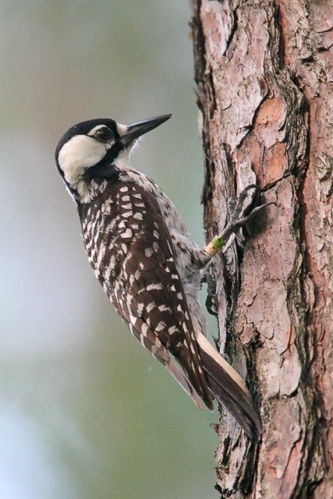
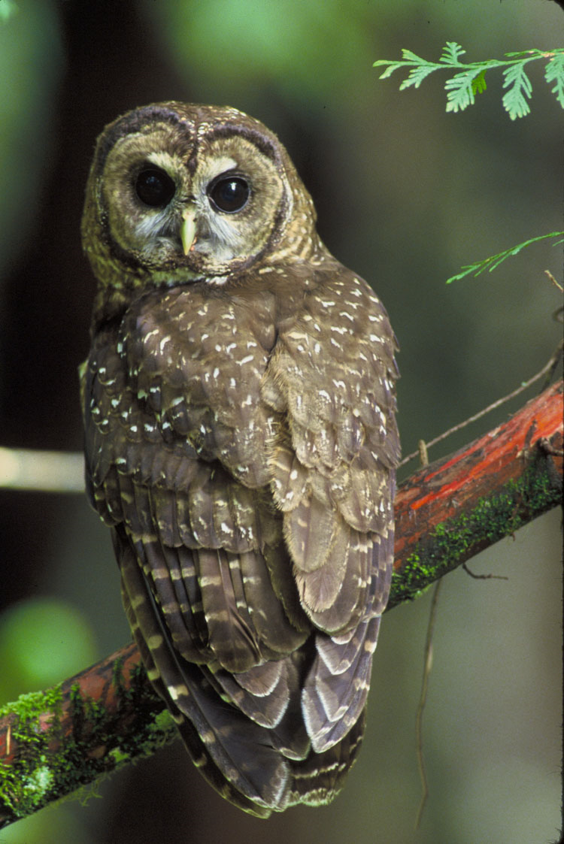

Slide 30
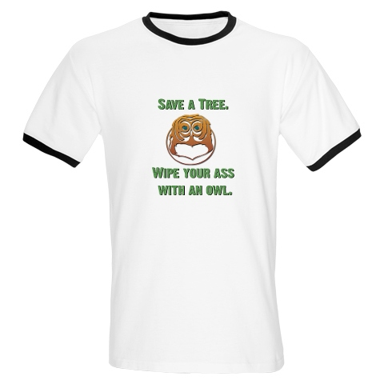
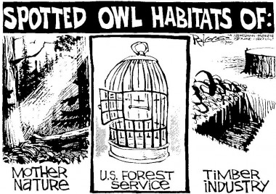
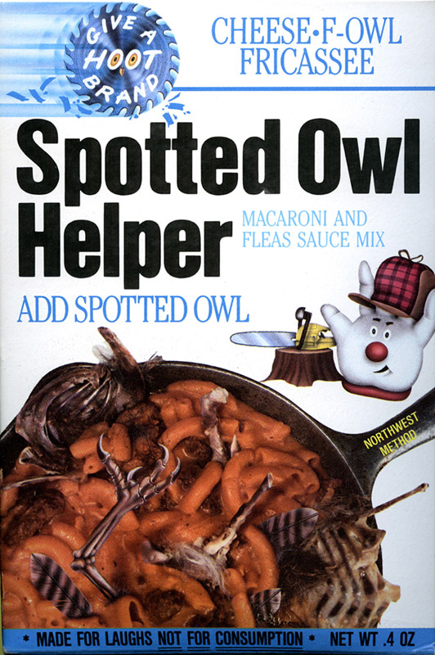
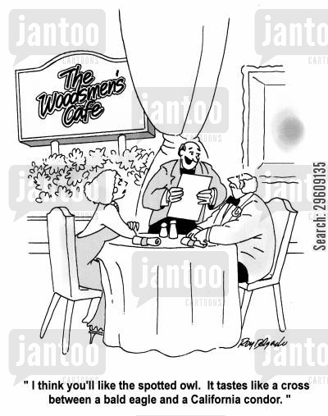
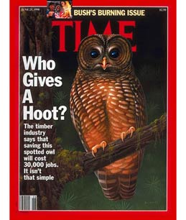
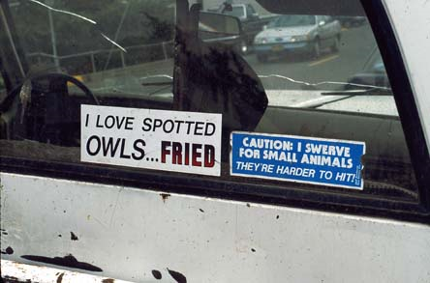

Slide 31
Years of Controversy
1975: FWS defined the word harm in the definition of take as,
  . . . an act or omission which actually injures or kills wildlife, including acts which annoy it to such an extent as to significantly disrupt essential behavioral patterns, which include, but are not limited to, breeding, feeding or sheltering; significant environmental modification or degradation which has such effects is included within the meaning of harm.
1979 (June): The United States District Court for the District of Hawaii issues its first substantive opinion in Palila v. Hawaii Department of Lands and Natural Resources (471 F. Supp. 985 (D. Hawaii 1979), aff'd 639 F.2d 495 (9th Cir. 1981)), holding that maintaining feral sheep and goats in the habitat of the endangered Palila (a bird) constituted take of the species because the browsing of the goats and sheep degraded the quality of the forest habitat on which the Palila depends.
1980 (November): Ronald Reagan was elected president.

Slide 32
1981: The United States Department of the Interior tried to redefine harm to exclude most, if not all, taking through destruction of habitat.
  DOI backed off and the final November 1981 definition, (p. 848, n.1), is an uneasy compromise.
1988 (June): The United States District Court for the Eastern District of Texas issued a §9 take ruling protecting red-cockaded woodpeckers, and enjoining timber harvesting on hundreds of thousands of acres of national forest land in east Texas. Sierra Club v. Lyng, 694 F. Supp. 1260.
1989: Northern spotted owl became a household phrase. Much of the effect of the listing of the northern spotted owl as a threatened species for private lands arose out of the threat of injunctions against timber harvest on the ground that it could constitute harm.

Slide 33
Timeline for this Case
1991 (June): A variety of groups “who depend directly or indirectly on the timber industry in the Pacific Northwest and in the Southeast” filed a lawsuit in the United States District Court for the District of Columbia, asserting a facial challenge to the 1981 harm definition.
1992 (May): Judge Norma Holloway Johnson of the District Court rejected their claim.
1993 (June): The D.C. Circuit affirmed (Mikva and Stephens, Sentelle dissenting)
1994 (March): In response to a petition for rehearing, the panel reversed its position (Stephens and Sentelle, Mikva dissenting) and held the regulatory definition exceeded the authority granted by the Endangered Species Act.
1995 (January): The Supreme Court granted certiorari.

Slide 34
§ 9(a)(1)(B)
… with respect to any endangered species of fish or wildlife listed pursuant to [§ 4] it is unlawful for any person subject to the jurisdiction of the Unites States to—
  take any such species within the United States or the territorial sea of the United States;

Slide 35
§ 3(19)
The tern “take” means to harass, harm, pursue, hunt, shoot, wound, kill, trap, capture, or collect, or to attempt to engage in any such conduct.

Slide 36
50 C.F.R. § 17.3
Harm in the definition of ‘‘take’’ in the Act means an act which actually kills or injures wildlife. Such act may include significant habitat modification or degradation where it actually kills or injures wildlife by significantly impairing essential behavioral patterns, including breeding, feeding or sheltering.

Slide 37
Plaintiffs’ case
Facial Challenge to the regulation defining harm. Arguing that Congress did not intend take to include habitat modification
  Senate’s original language would have included habitat modification but Senate deleted that language before enactment
  Senate added the term harm to the statute in a floor amendment without debate

Slide 38
What does Harm mean?
Dictionary: to cause hurt or damage to: injure
Broad Statutory Purposes: to provide a means whereby the ecosystems upon which listed species depends may be conserved
  Purpose to halt trend toward species extinct whatever the cost (TVA v. Hill)
1982 Amendments indicate that Congress understands takes to include both deliberate and incidental takings

Slide 39
O’Connor (Concur) Scalia (Dissent)
Proximate Causation
  Foreseeability
  Fairness of imposing liability for remote consequences
Harm
  Impairment of breeding?
  Interference with breeding?
  This reading of the ESA conscripts farmers’ land to national zoological use
  Should be about injuries to species as a whole (like section 7) not individuals→ injury to a population

Slide 40
Current Species Protection in Place

Slide 41
Incidental Take Permits
Section 10

Slide 42
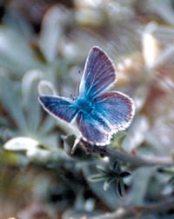

Section 10 Permit Program
1982 Amendments to the Act
San Bruno Mountain
Incidental Take Permits
Habitat Conservation Plans

Slide 43
Section 10(a)(1) (p. 839)
The Secretary may permit, under such terms and conditions as he shall prescribe—
  (A) Any act otherwise prohibited by section 1538 [§9] for scientific purposes or to enhance the propagation or survival of the affected species . . . or
  (B) Any taking otherwise prohibited by [§9(a)(1)(b)] . . . if such taking is incidental to, and not the purpose of, the carrying out of an otherwise lawful activity.

Slide 44
Section 10(a)(2) (p. 839)
(A) No permit may be issued by the Secretary authorizing any taking . . . unless the applicant therefor submits . . . a conservation plan that specifies—
  (i) the impact which will likely result from such taking;
  (ii) what steps the applicant will take to minimize and mitigate such impacts, and the funding that will be available to implement such steps;
  (iii) [alternatives considered]
  (iv) such other measures that the Secretary may require as being necessary or appropriate . . . .

Slide 45
Section 10(a)(2)(B)
If the Sec’y finds, after opportunity for public comment, with respect to a permit application and the related conservation plan that—
  the taking will be incidental;
  the applicant will, to the maximum extent practicable, minimize and mitigate the impacts of such taking;
  … adequate funding for the plan will be provided;
  the taking will not appreciably reduce the likelihood of the survival and recovery of the species in the wild; and
  [required]measures .. will be met; … the Sec’y shall issue the permit …

Slide 46
Wildearth Guardians v. USFWS
622 F. Supp. 2d 1155 (D. Utah 2009)
p. 849

Slide 47
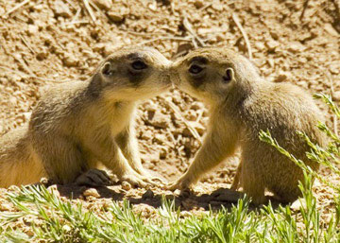
Utah Prairie Dogs
http://www.nps.gov/brca/parknews/updday.htm

Slide 48
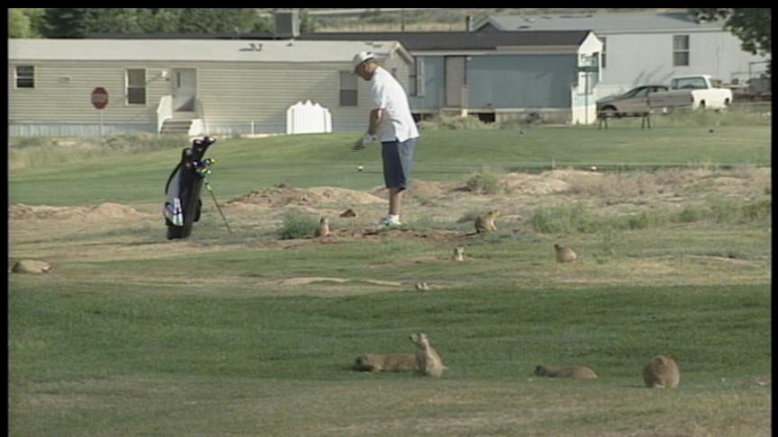

Slide 49
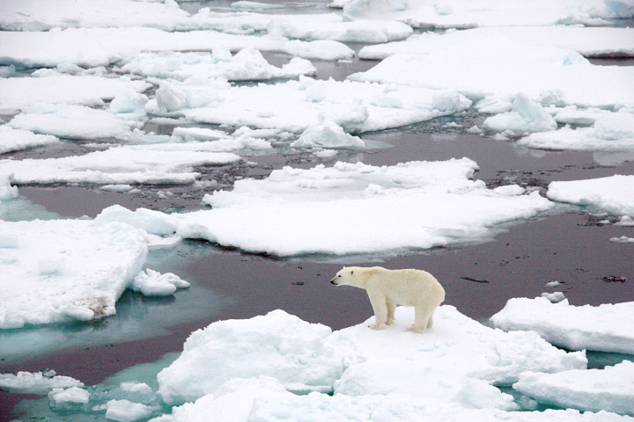
Polar bear and sea ice
Source: NASA (Fruchtzwerg)

