Slide 1
Natural Resources
Class #17
April 10, 2018

Slide 2
Water
Overview

Slide 3
Creating a Water Law System
C
D
E
A
B
800 cfs
F
G
900 cfs
600 cfs
950 cfs
200 cfs
100 cfs
1000 cfs

Slide 4
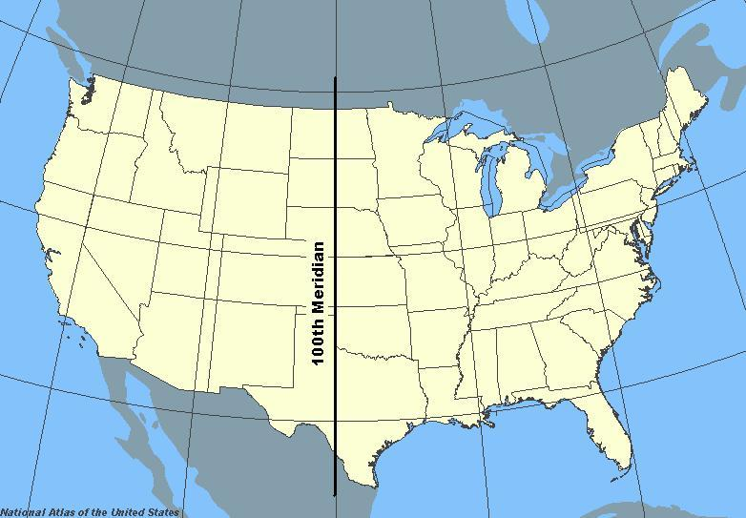

Slide 5
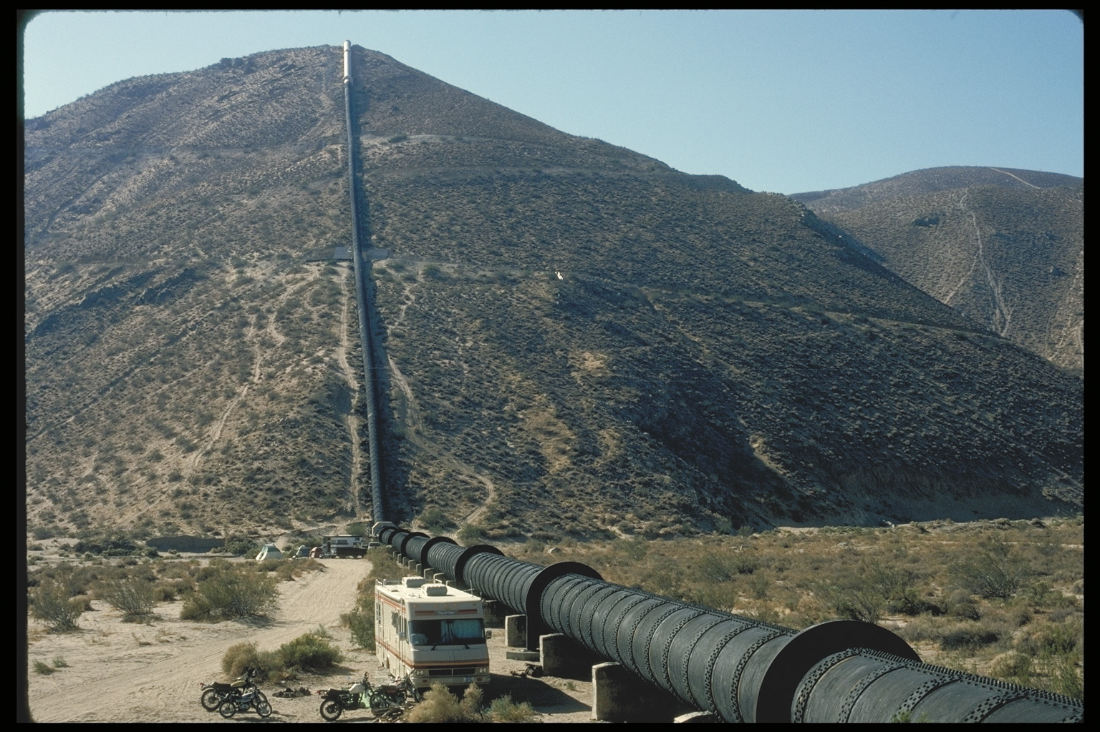
Source: G. Donald Bain

Slide 6

<<need to acquire photo>>
Billboard in Michigan, “Back Off Suckers, Water Diversion . . . The Last Straw.” Source: Mark Heckman, MarkHeckmanArt.

Slide 7
State Law
The Riparian Doctrine

Slide 8
Subdivision of Riparian Lands
Source of Title
Unity of Title
A
C
B

Slide 9
Riparianism
Natural Flow
Reasonable Use
Municipal Water Supply
Irrigation
Recreation
Wildlife Habitat
Navigation
Hydro-power
Same Quantity
Same Quality

Slide 10
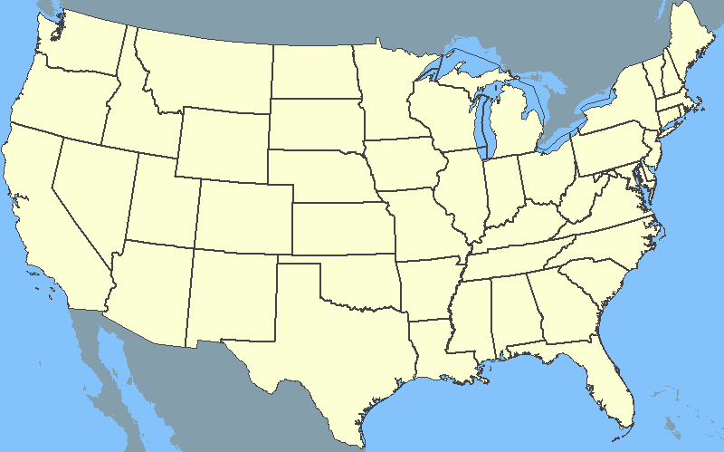
2
1
Gordonsville v. Zinn
Hoover v. Crane

Slide 11
Gordonsville v. Zinn
106 S.E. 508 (Va. 1921) (Sims, J.)
p.867

Slide 12
#1
#4
#2
#3
To Mrs. Zinn’s house
Cameron Spring
Gordonsville Reservoir
#1 – Cameron Tract (acquired pre-1889)
#2 – Mrs. Zinn’s 42/100 acre (acquired 1917)
#3 – Gordonsville Tract (acquired 1889)
#4 – Mrs. Zinn’s 58 acres (acquired 1915)
To town of Gordonsville

Slide 13
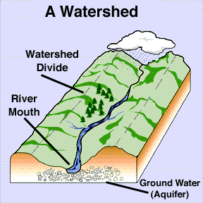
Watershed Approach
To be riparian one must be located on the watershed of that portion of the stream in question

Slide 14
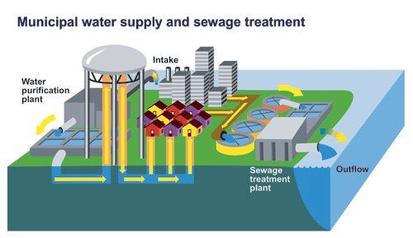
Municipal Water Supplies
Riparian Landowners
Legislative Acts
Eminent Domain
Prescription

Slide 15
Hoover v. Crane
106 N.W.2d 563 (Mich. 1960) (Edwards, J.)
p.872

Slide 16
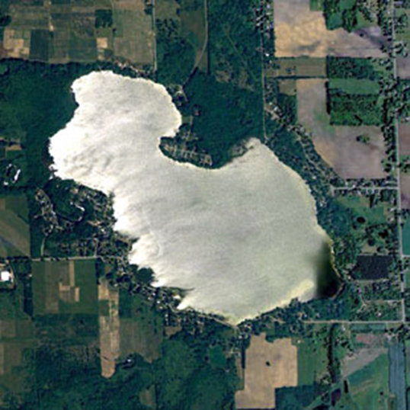
Hutchins Lake

Slide 17
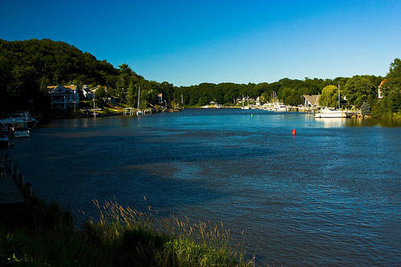
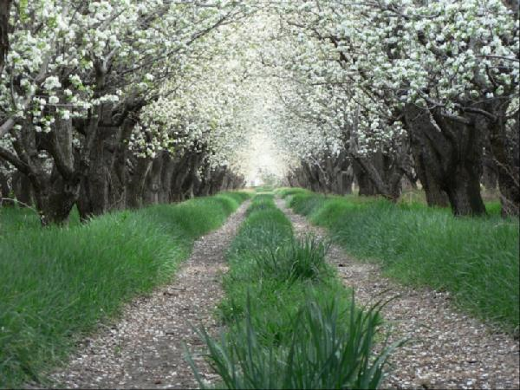
Reasonable Use?

Slide 18
The Restatement (Second) of Torts
§843. Riparian Land Defined
§850. Harm by One Riparian Proprietor to Another
§850A. Reasonableness of the Use of Water
§855. Nonriparian Uses by Riparian Proprietors
Pp. 875-76

Slide 19
850: Harm by One Riparian Proprietor to Another
A riparian proprietor is subject to liability for making an unreasonable use of the water of a watercourse or lake that causes harm to another riparian proprietor’s reasonable use of water or his land.

Slide 20
850A: Reasonableness of the Use of Water
The determination of the reasonableness of a use of water depends upon a consideration of the interests of (1) the riparian proprietor making the use, (2) of any riparian proprietor harmed by it and (3) of society as a whole. Factors that affect the determination include the following:
  The purpose of the use
  The suitability of the use to the watercourse or lake
  The economic and social values
  Harm caused by the use and the practicability of avoiding it
  Protection of existing values of water uses and land
  Justice

Slide 21
Creating a Water Law System
C
D
E
A
B
800 cfs
F
G
900 cfs
600 cfs
950 cfs
200 cfs
100 cfs
1000 cfs

Slide 22
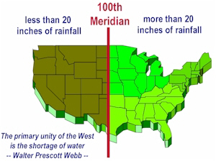
The Prior Appropriation Doctrine

Slide 23
1
2
Irwin v. Phillips
R.J.A., Inc. v. Water Users Association

Slide 24
Irwin v. Phillips
5 Cal. 140 (Cal. 1855)
p. 880

Slide 25
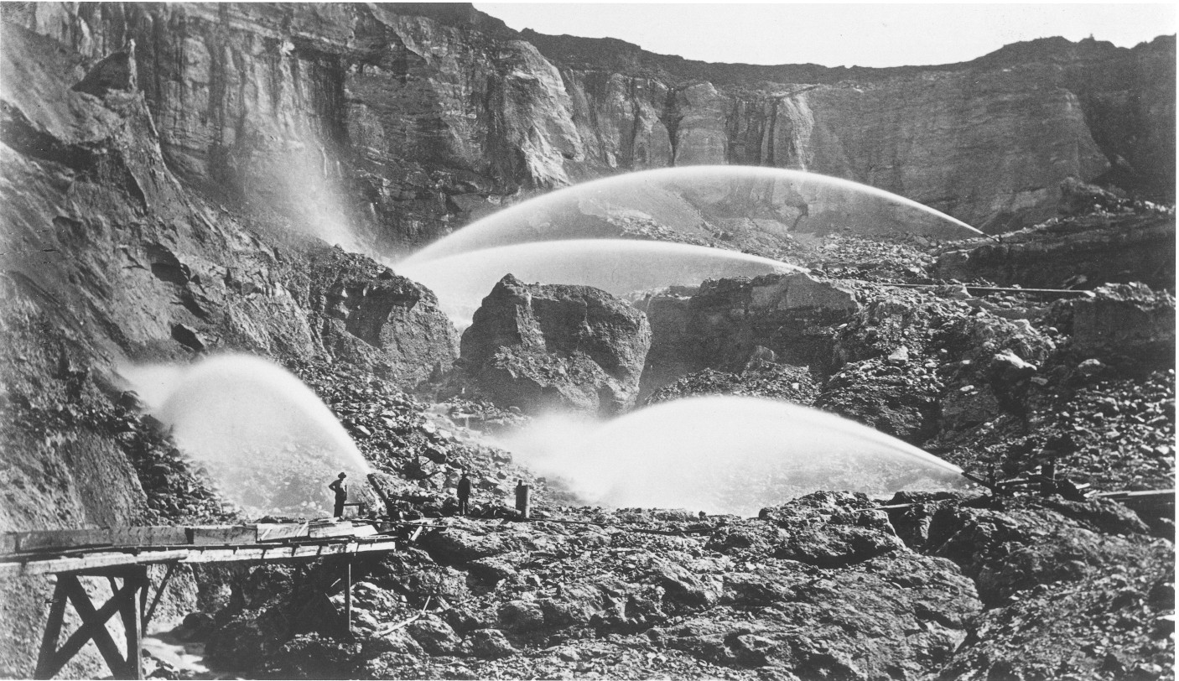
Photo by Carleton E. Watkins, “Hydraulic Mining. Malakoff Diggins, North Bloomfield, Nevada Co.”
Source: California Historical Society, FN-29110

Slide 26
The Law of the Mining Camp
Courts are bound to take notice of the political and social condition of the country, which they judicially rule.
TRANSLATION→ “We as judges would be crazy to impose rules that we cannot enforce, contrary to the customs already established in the rough-and-tumble mining camps.”

Slide 27
R.J.A., Inc. v. Water Users Association
690 P.2d 823 (Colo. 1984) (Lohr, J.)
p.882

Slide 28
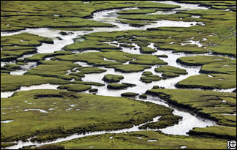
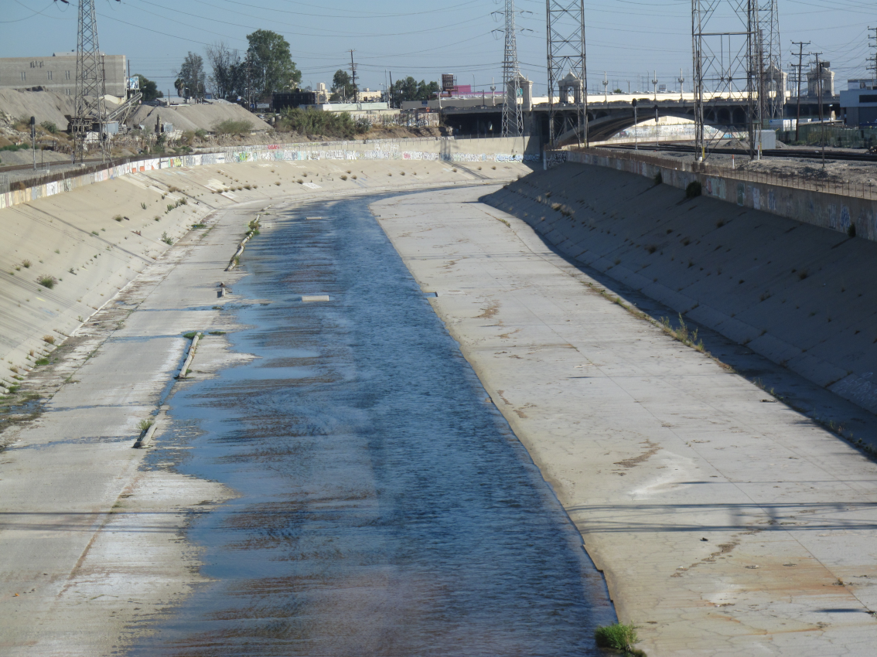
←Saturated seepy condition with high evaporation and evapotranspiration
Unimpeded drainage and high flows →

Slide 29
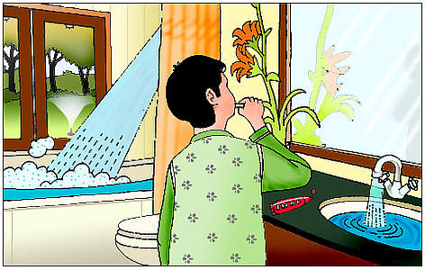
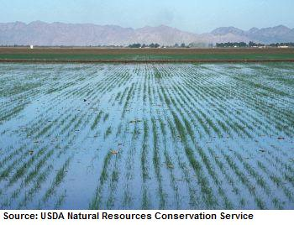
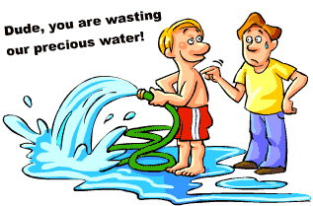
Waste

Slide 30
Regulated Riparianism

Slide 31
Obtaining a Water Use Permit
3-Prong Test
14 Criteria (well some of ‘em)
Applicant must show that the proposed use of water:
  Is reasonable-beneficial
  Will not interfere with ay presently existing legal water use
  Is consistent with the public interest
Water use
  Is necessary to fulfill certain reasonable demands
  No adverse impacts on water resources
  No adverse impacts on wetlands, lakes, wildlife, etc.
  Lowest water quality
  No saline intrusion
  Use water conservation

Slide 32
The Regulated Riparian Model Water Code
Water is a natural resources owned by the State in trust. State must protect public, health, safety and welfare.
No prohibition of use based on location
Minimum Flow Requirements
Permits required (limited in duration)

Slide 33
Groundwater

Slide 34
Groundwater Discussion Question (902-903)

Slide 35
Results:
Prior appropriation
  Waste Issue?

Slide 36
Results:
Prior appropriation
English absolute ownership

Slide 37
Results:
Prior appropriation
English absolute ownership
American reasonable use

Slide 38
Results:
Prior appropriation
English absolute ownership
American reasonable use
Correlative rights

Slide 39
Results:
Prior appropriation
English absolute ownership
American reasonable use
Correlative rights
Restatement (Second) of Torts

